Slide 1
Mining public datasets for driving forces of immune-related adverse events (irAEs) from immune checkpoint blockade (ICB)
2-1-2024 SI meeting
Ty Bottorff – Bioinformatics postdoc
Linsley lab

Slide 2
Outline
irAE introduction
Crossreactive T cell hypothesis
scRNAseq + scTCRseq dataset methods
Mining datasets for differences between irAE groups

Slide 3
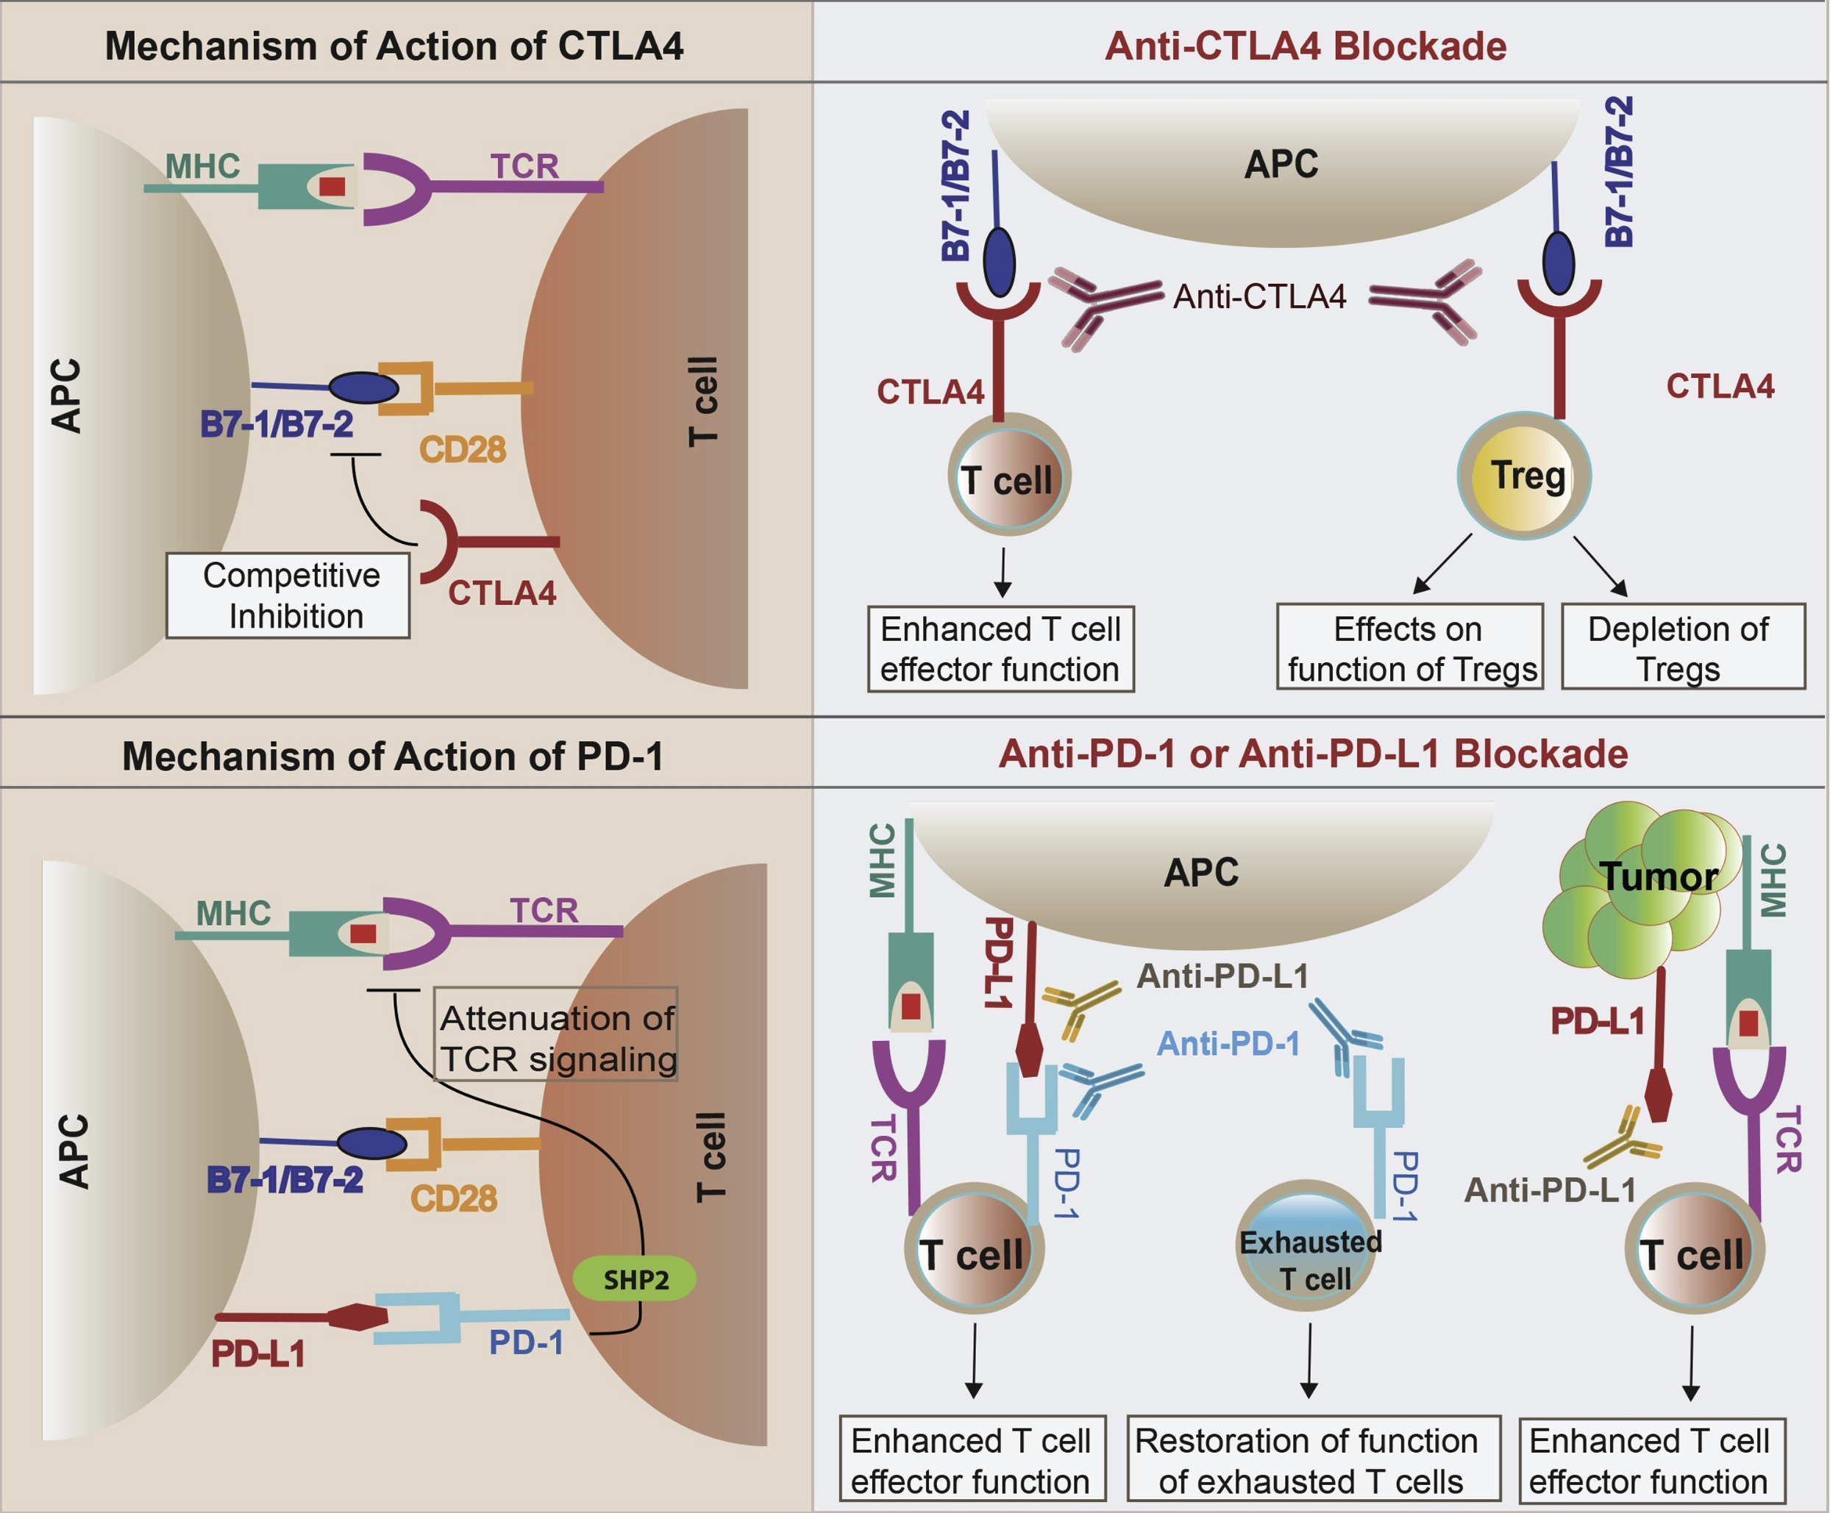
Immune checkpoints help maintain self tolerance
PMID31330185

Slide 4
Immune checkpoint blockade (ICB) has revolutionized cancer treatment
PMID31330185
Notes:
In 2011, ipilimumab (Yervoy) became the first ICI to receive FDA approval for metastatic melanoma. As of 2023, it remains the only CTLA-4 targeting ICI that received FDA approval
Mechanisms of immune-related adverse events during the treatment of cancer with immune checkpoint inhibitors
anti-CTLA-4 and anti-PD-1/PD-L1 antibodies called "immune enhancers" and "immune normalizers" (normalizing T cell immunity in tumor microenvironment), respectively, consistent with PD-1 blockade having less irAEs

Slide 5
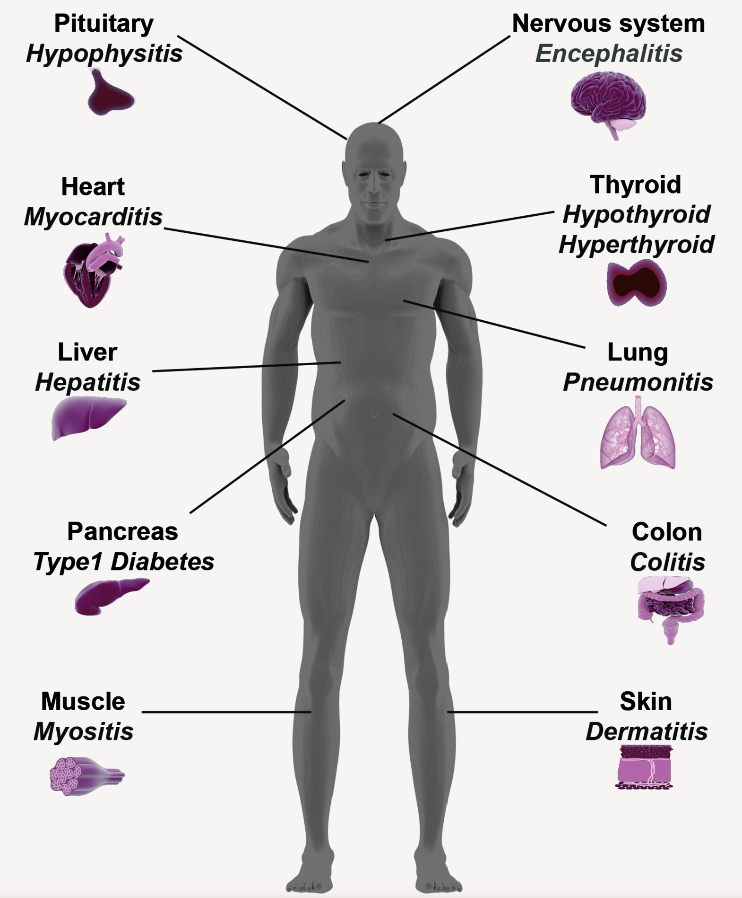
ICB can lead to the development of immune-related adverse events (irAEs)
PMID31330185

Slide 6
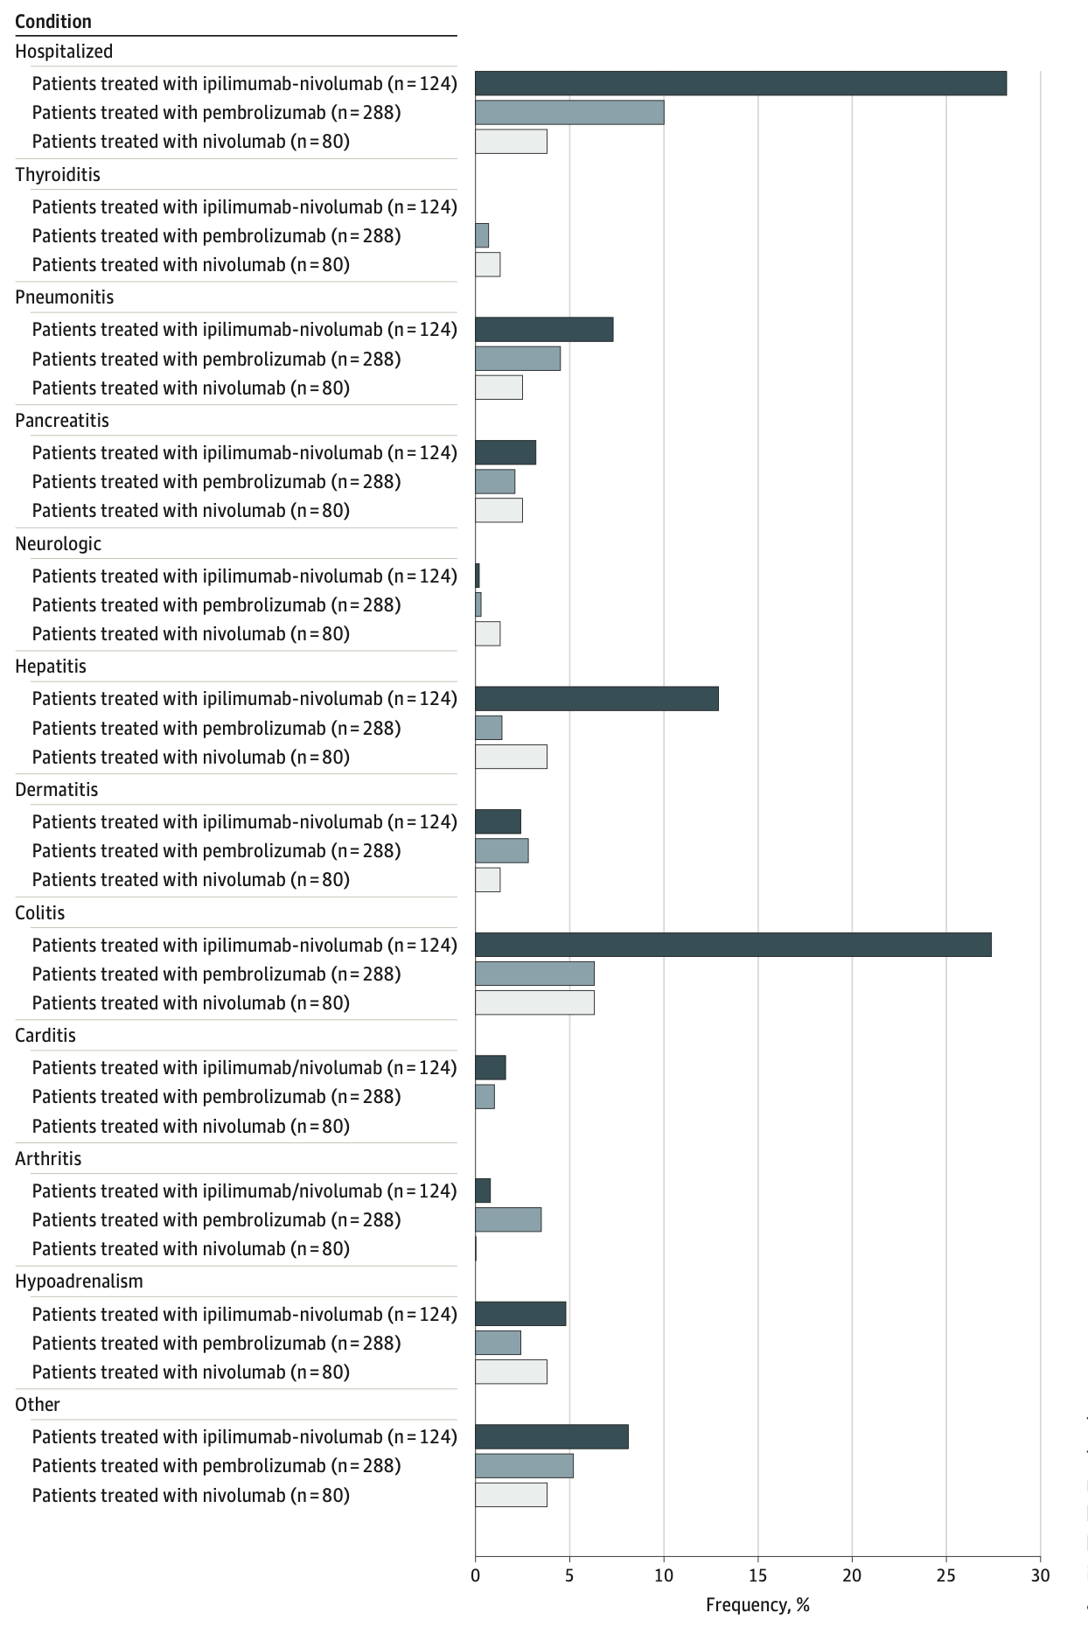
irAEs are rather common and can be severe
PMID36480204
Notes:
T cell characteristics associated with toxicity to immune checkpoint blockade in patients with melanoma
Autoimmune toxicity occurs in up to 60% of patients treated with immune checkpoint inhibitor (ICI) therapy
Ipilimumab: CTLA-4
Pembrolizumab/nivolumab: PD-1
Perhaps worth trying to make analogy between viral infections preceding autoimmunity and tumor response preceeding irAEs?

Slide 7
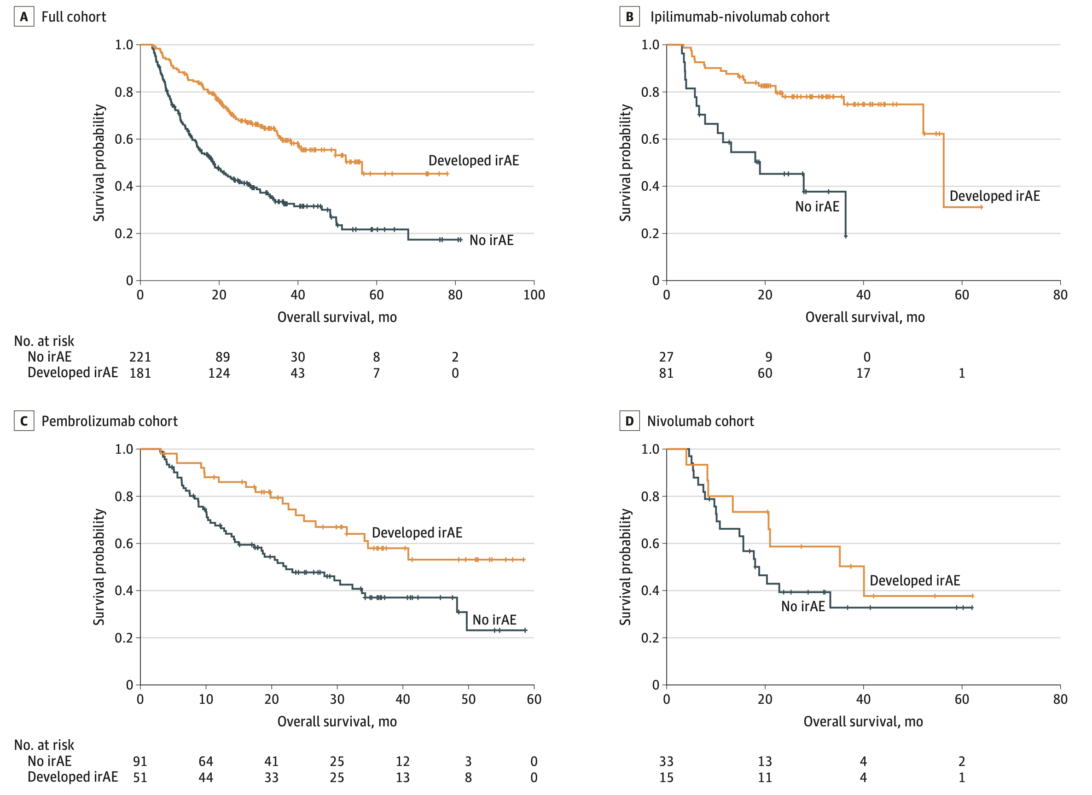
irAE development is generally associated with anti-tumor response (PMID31021392, PMID26501224, PMID26446948)
PMID36480204
Notes:
Association of checkpoint inhibitor-induced toxic effects with shared cancer and tissue antigens in non-small cell lung cancer:
irAEs associated with response to therapy (also can cite Association of vitiligo with tumor response in patients with metastatic melanoma treated with pembrolizumab), also Nivolumab in resected and unresectable metastatic melanoma: characteristics of immune-related adverse events and association with outcomes
Characterization of anti-cancer immune response associated with immune-related adverse events in patients with kidney cancer (meeting abstract)
- more irAEs in ICB responders, not a new finding

Slide 8
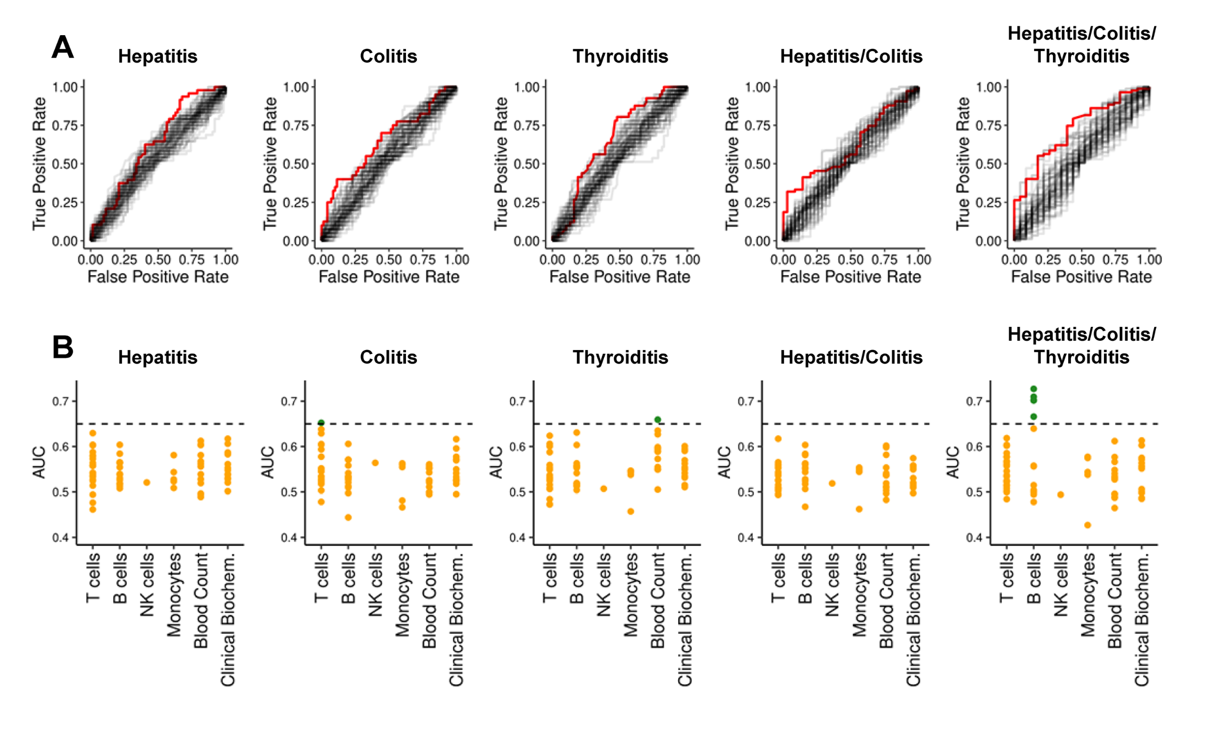
Pre-therapy data struggle to reliably predict irAE risk
AUCs for previously reported biomarkers and clinical parameters (68)
PMID36248910
Notes:
An AUC of 0.5 suggests no discrimination (equivalent to random guessing), while an AUC of 1 indicates perfect discrimination (for predicting irAE)
heterogeneity amongst irAE organs likely complicates prediction
Germline variants associated with toxicity to immune checkpoint blockade: IL7 cryptic exon, IL7 supports aberrant immune activity in autoimmunity, limits organ toxicity during antiviral immune response, blocks PD-1 leading to T1D (blocking checkpoint when it would have prevented autoimmunity, so IL7 acts as a natural ICB and is therefore rationally associated with irAEs
lower baseline levels of CD8 TCM cells in arthritis irAE patients, higher CD4 Th2 baseline levels in pneumonitis irAE patients, higher CD4 Th17 baseline levels in thyroiditis irAE patients (PMID: 36513074)
low baseline circulating MAITs associated with irAE colitis (PMID: 32734627, ~coincides with my analysis)
activated CD4 TEM abundance (in PBMCs) associated with irAE development (PMID: 35027754, ~disagrees with my analysis)
T cell characteristics associated with toxicity to immune checkpoint blockade in patients with melanoma: BASELINE activated CD4 effector memory T abundance and TCR diversity associated with irAE

Slide 9
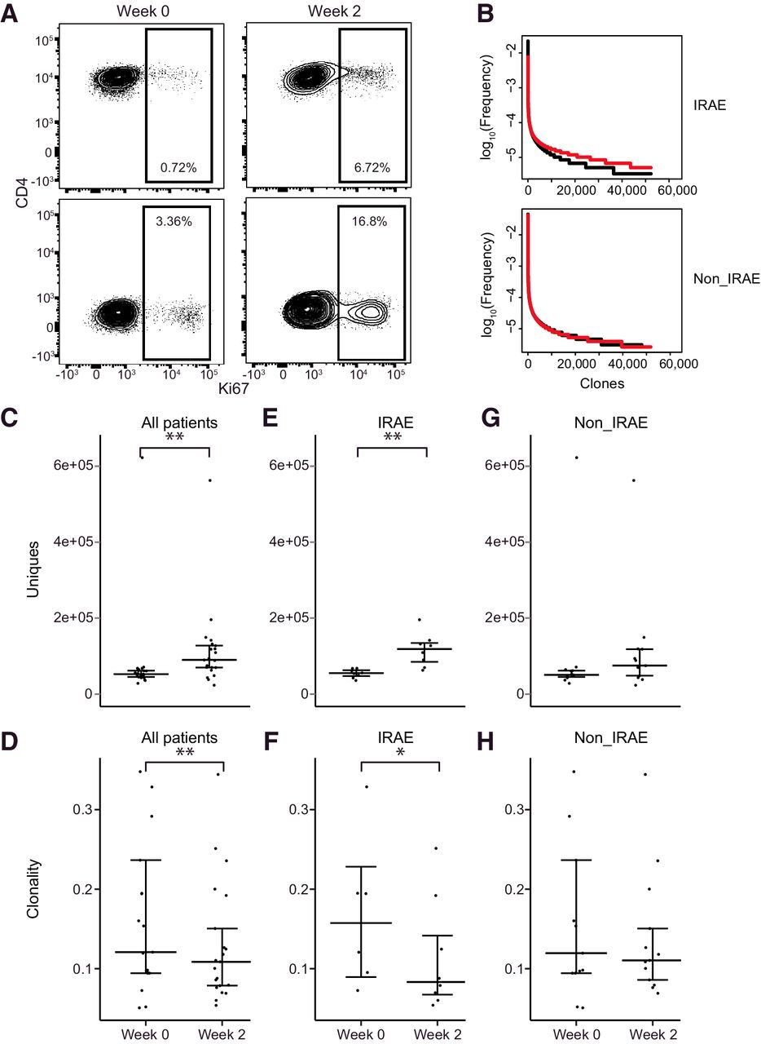
On therapy T cell expansion, repertoire diversification associated with irAE development (PMID33643899, PMID28031229, PMID27698113)
C, E, G: # unique clones
PBMCs
n = 8 (irAE), n = 13 (no irAE)
**: p < 0.01, *: p < 0.05
Notes:
Biomarkers of checkpoint inhibitor induced immune-related adverse events - a comprehensive review: on treatment markers including clonal expansion of more T cell clones, more newly emerging T cell clones, decline in T cell clonality all very interestingly associated with more irAEs
Checkpoint blockade-induced dermatitis and colitis are dominated by tissue-resident memory T cells and Th1/Tc1 cytokines
Clinical outcome following checkpoint therapy in renal cell carcinoma is associated with a burst of activated CD8 T cells in blood: model: pool of tumor-specific TCF-1<sup>+</sup> stem-like CD8 T cells that aren't proliferating or generating antitumor effector cells that are a reservoir unleashed by ICB, seen by large burst of HLA-DR<sup>+</sup> CD38<sup+</sup> CD8 T cells after ICB and new repertoire
clonal replacement: recruitment of less dysfunctional peripheral T cell clonotypes to tumor that were not detectable in tumor prior to PD-1 blockade, i.e. from tumor draining lymph node, more important in ICI than previously thought
clonal revival: replenishment of highly dysfunctional T cell clones in tumor with new, less dysfunctional T cells (perhaps from periphery, local expansion within tumor) that can be novel clonotypes (i.e. clonal replacement) or clonotypes pre-existing in tumor
Distinct cellular mechanisms underlie anti-CTLA-4 and anti-PD-1 checkpoint blockade
- PD-1 blockade predominantly induces expansion of specific tumor infiltrating exhausted-like CD8<sup>+</sup> T cell subsets
- CTLA-4 blockade induces expansion of ICOS<sup>+</sup> Th1-like CD4<sup>+</sup> effector T cells, also engages specific subsets of exhausted-like CD8<sup>+</sup> T cells
Immune-related adverse events in checkpoint blockade: observations from human tissue and therapeutic considerations
PD-1 blockade more CD8 effect, CD4 effect more for CTLA-4 blockade
Oh et al. Cancer Res. 2018
CTLA-4 blockade induced greater diversification of T cell repertoire (more clonotypes including newly detected clones, decreased clonality) in irAE patients compared to no irAE patients

Slide 10
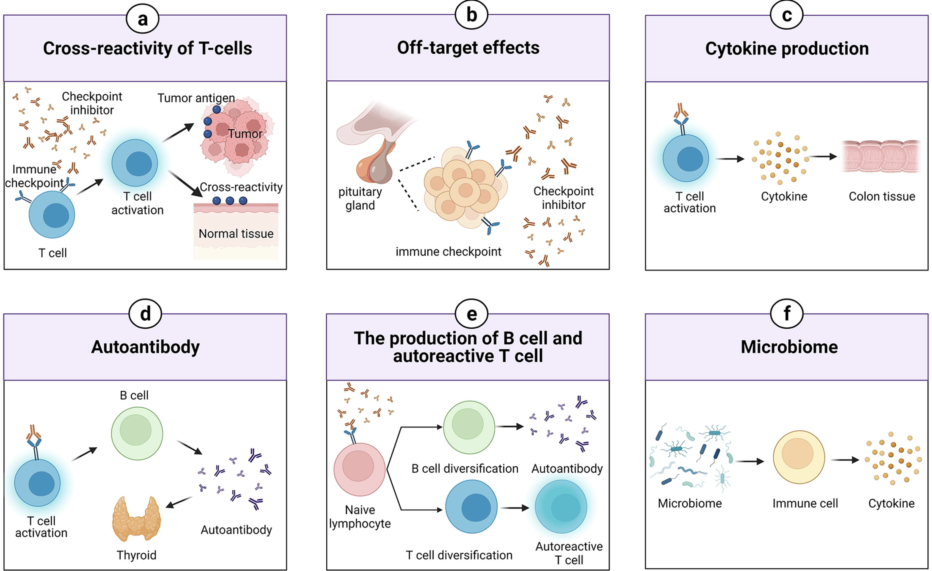
Possible mechanisms driving irAEs
Zheng et al. Materials & Design. 2022
Notes:
(b) ICIs can target normal tissues such as hypothalamic and pituitary tissues directly which express immune checkpoint ligand
(c) Activated T cells can release inflammatory mediators which lead to damage in normal tissues
(d) The production of autoantibodies is associated with the risk of irAEs
(e) ICIs can induce the diversification of lymphocytes as well as promoting T/B cell activation and proliferation
(f) The microbiome with certain bacterial species can shift immune lineage to pro-inflammatory or anti-inflammatory subtypes respectively thereby inducing or resisting irAEs

Slide 11
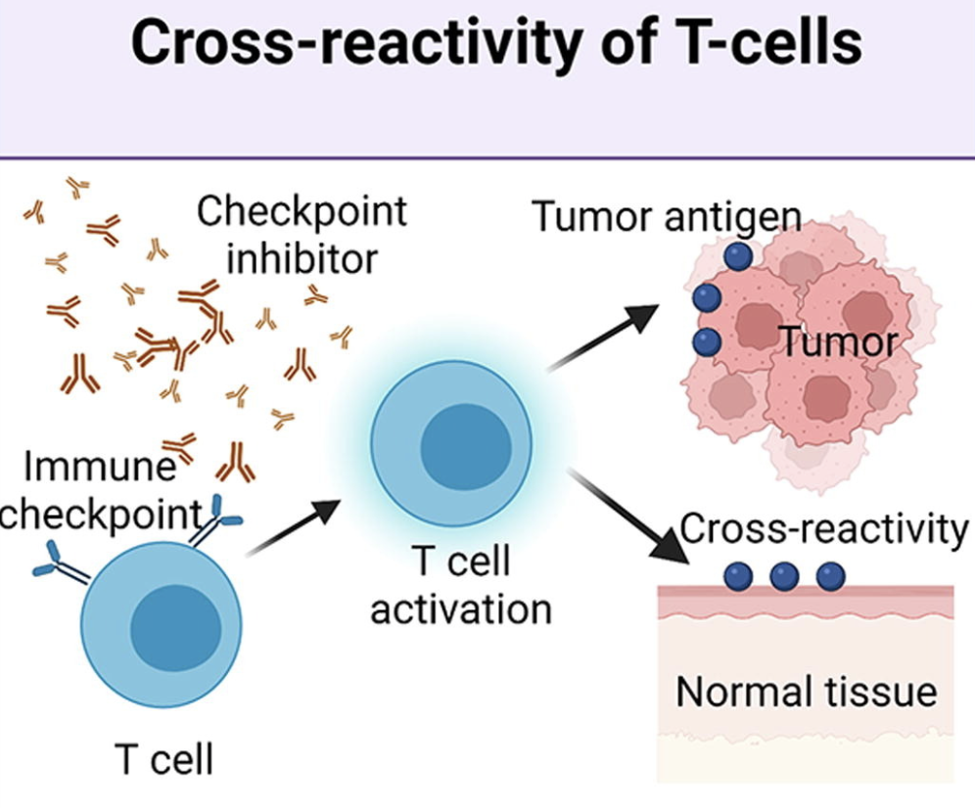
Crossreactive T cells may cause irAEs via reaction to both tumor and self
TCRs estimated to potentially react with 1 in ~10k encountered peptides (PMID37409132)
infiltration of T cells in irAE tissue (PMID31021392, PMID35101349)
sharing between TCR clonotypes infiltrating primary tumor and irAE tissue (PMID31021392, PMID30832716, PMID34589959) and metastases and irAE tissue (PMID37680638)
more peripheral T cell clones shared with TILs in irAE patients (PMID30832716)
Zheng et al. Materials & Design. 2022
Notes:
Gouttefangeas et al. Front Immunol. 2023
TCR conceivably could recognize ~ 1 million peptides, crossreactive peptides likely often better agonists than original one that activated T cell, but few (~1%) of peptides are actually presented on MHC, so probably crossreactivity estimate closer to 1 in ~10,000
estimate TCRs to be able to bind ~10^5 to 10^6 peptides (Amino acid similarity accounts for T cell crossreactivity and for "holes" in the T cell repertoire)
Berner et al. JAMA Oncology, 2019
skin second most similar to NSCLC after lung and had second highest proportion of irAEs (also Autoreactive napsin A-specific T cells are enriched in lung tumors and inflammatory lung lesions during immune checkpoint blockade)
same T cell clonotypes infiltrated both lung tumor and autoimmune skin lesions
Speculation for what crossreactive T cells are actually targeting, perhaps T cells targeting cancer neoantigens cross-react with WT version of protein in healthy tissue (Autoreactive napsin A-specific T cells are enriched in lung tumors and inflammatory lung lesions during immune checkpoint blockade)
What makes TCRs crossreactive? cross-reactivity need not result from sequence similarity (3D structural similarity more important than 1D sequence similarity (Peter’s paper: Autoreactive T cell receptors with shared germline-like α chains in type 1 diabetes)
Kato et al. Journal of Clinical Oncology, 2023
- some irAE-provoked T cell clones circulate systemically and attack tumor cells leading to ICB response in irAE patients or vice a versa some tumor-provoked T cell clones circulate systemically and attack self leading to irAEs? not sure how they differentiate between the two
Subudhi et al. Proc Natl Acad Sci USA, 2016
CD8 T cell clonal expansion was greater in patients developing severe irAEs
Effective use of latent semantic indexing and computational linguistics in biological and biomedical applications: HLA-B57 restricted T cells are more crossreactive to mutants of target epitopes, this HLA allele also associated with autoimmunity
PMID: 33597266
- expansion of peripheral CD8+ T cell populations specific for melanocyte antigens observed only in patients who responded to anti-PD-1 therapy, so ICI can promote breakdown of tolerance towards tumor-lineage self-antigens
- perhaps in responders with low neoantigen tumors more often will see irAEs given necessity for immune activity against tumor associated antigens shared between tumor and self
Rapisuwon et al., J Immunother Cancer, 2019
identical CD8+ T cell clone found in 4 tissues in a patient with widespread irAEs (duodenum for enteritis irAE, PBMCs, original tumor and liver metastasis responses as well), evidence for crossreactivity underlying irAEs OR common antigen between tumor and self underlying irAEs
duodenitis blocked by antibody to integrin α 4 β 7 (LPAM-1) which blocks T cell infiltraton into GI tract, suggesting that GI toxicity resulted from circulating T cells trafficked to GI tract following expansion elsewhere i.e. in the tumor perhaps
Global analysis of shared T cell specificities in human non-small cell lung cancer enables HLA inference and antigen discovery: autoreactive T cells in peripheral blood may exist (pruned but not clonally deleted thymus) to avoid immunologic "blind spots" to pathogens, i.e. pathogens that look like self would get by free otherwise if we didn't have some autoreactivity perhaps
Heterogeneity of autoreactive CD8+ T cells at sites of inflammation
shared clonal origin among CD8+ T cells at site of colitis with gut Trm cells, suggesting clonal expansion from Trm population being responsible for irAEs (different from autoimmune, so for tissues that lack Trm cells, like the synovium, trafficking of T cells from the periphery may be important for irAEs)
PMID: 35101349
T cells seen infiltrating into irAE tissue, T cells seen targeting irAE tissue seen in blood, so T cells involved in irAEs
autoantibodies present ~50% of time for irAEs
Improved survival with T cell clonotype stability after anti-CTLA-4 treatment in cancer patients
diverse repertoires are important in limiting the magnitude of immune escape but may also promote self-reactive clones and induce host inflammation
Carbone et al. Front Immunol. 2023
they usually find different TCR sequences in vitiligo and primary melanoma lesions, so T cell response against normal melanocytes leading to vitiligo is not usually mediated by reactivation of T cell clones infiltrating/specific to primary melanoma but rather perhaps by T cells targeting metastatic tissues, so kind of different from my thinking of usually crossreactivity between primary tumor and irAE site but could also be crossreactivity between metastases and irAE sites
metastasis and vitiligo sample TCRs more similar than primary melanoma and vitiligo TCRs
Interpreting T cell crossreactivity through structure: implications for TCR-based cancer immunotherapy
crossreactivity driven by structural similarities of seemingly unrelated pMHCs (by sequence)
PMID: 34589959
can see same clonotypes of T cells reactive against tumor and self in irAEs
Other hypotheses: off-target effects (hypothalamus and pituitary express IC ligand), cytokine production damage normal tissue, autoantibodies, microbiome (proinfammatory)

Slide 12
Goals
Determine if TCR (junction) features can serve a proxy for or predispose to T cell cross-reactivity
Features to investigate
Junction length (PMID33289628, PMID12152083, PMID9597140), chemical properties (PMID35177831)
TCR germline-ness (probability of generation)
Possible effects of feature variations
Altered TCR-pMHC contact geometry, binding modes, number of contacts
Mine datasets for T cell differences between patients developing and not developing irAEs
Notes:
Additional possible effect that I’m not sure how to talk about: altered diversity?
Initially thought that more germline-like TCRs might be more cross-reactive as they have lower sequence complexity, don’t fully understand that hypothesis though…
Hydrophobicity: more hydrophobic TCRs might be more cross-reactive as they allow more alternative contacts
Entropic contributions and the influence of the hydrophobic environment in promiscuous protein-protein association: interface demonstrates promiscuity in part due to the number of interactions this hydrophobic interface allows, which allows many alternative contacts (increased entropy, drives forward binding) with other binding partners hence promiscuity
Repertoire analyses reveal T cell receptor sequence features that influence T cell fate
TRB CDR3 hydrophobicity promotes reactivity to self-peptides
Functionally specialized human CD4+ T cell subsets express physiochemically distinct TCRs: longer CDR3s might promote crossreactivity
Statistical analysis of CDR3 length distributions for the assessment of T and B cell repertoire biases:
The length of the CDR3 loop greatly influences its shape and ability to fold both on itself and in the company of others loops such as the CDR1 and CDR2

Slide 13
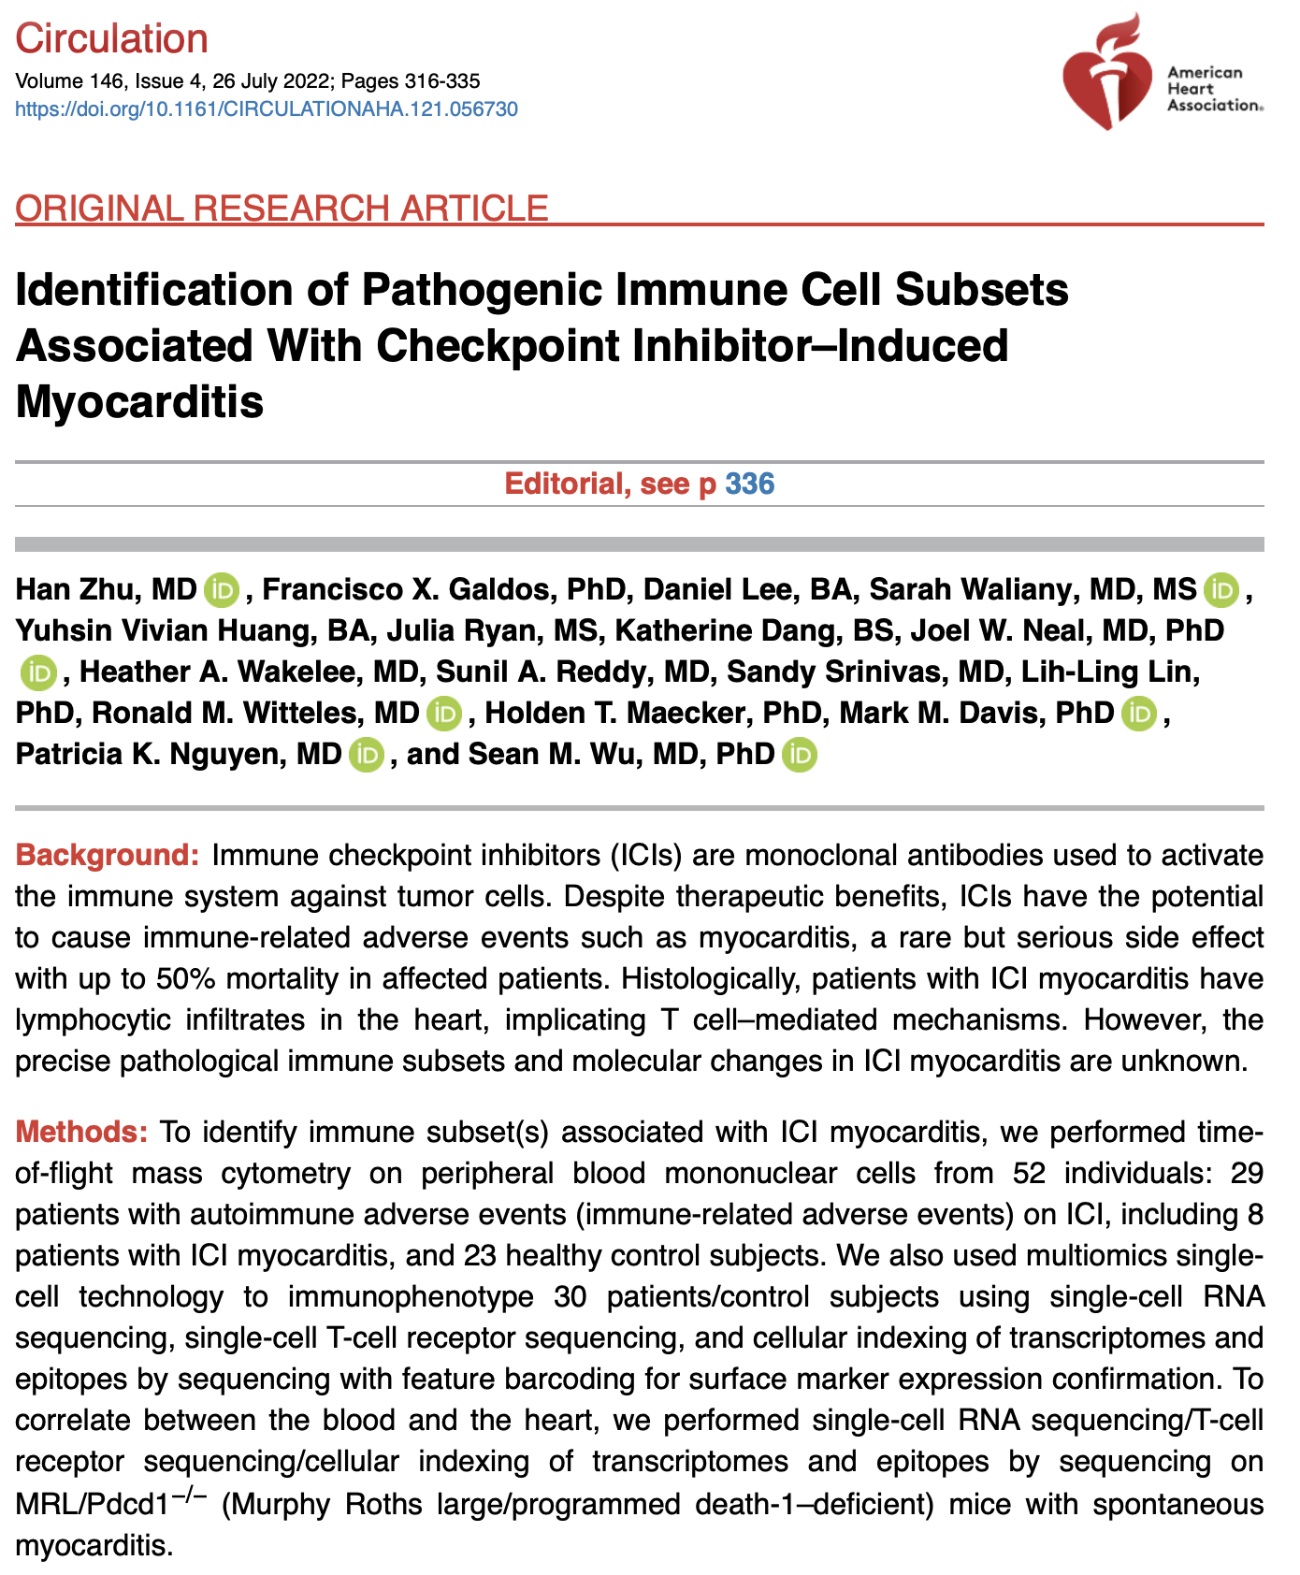
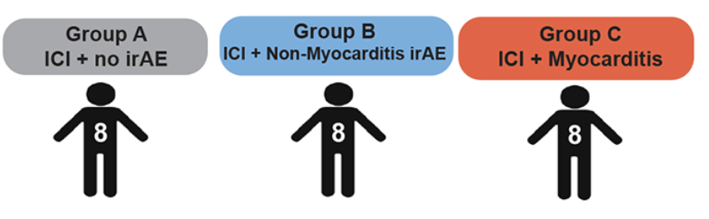
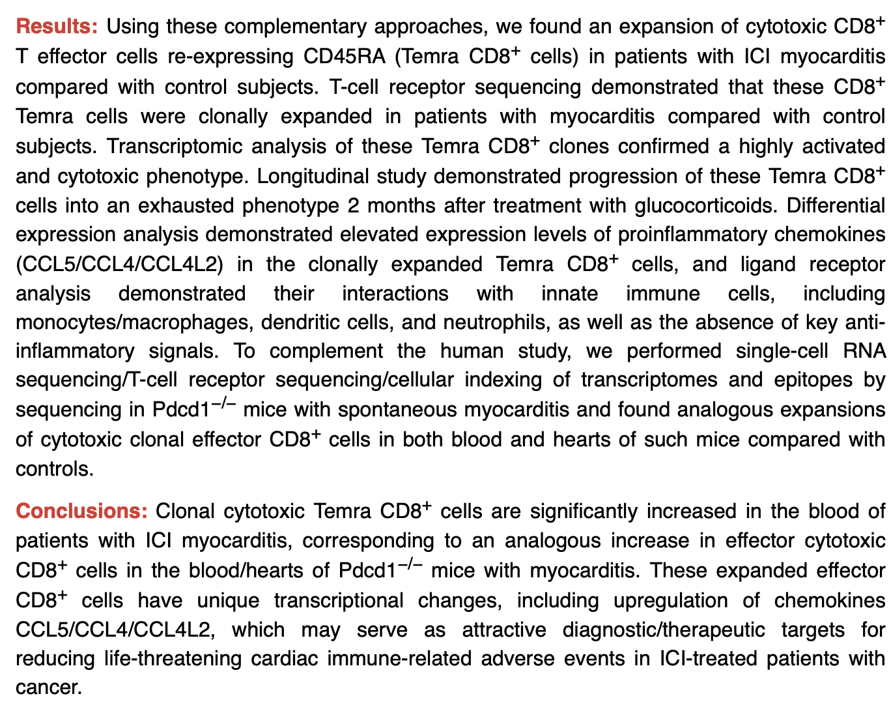
Pool groups B & C for power
PMBCs
Notes:
Seq details:
Sequencing of all 10x Genomics libraries was performed through Medgenome (Foster City,
California). 5’ library, TCR library, and feature barcoding libraries were all sequenced on the Illumina
NovaSeq 6000 instrument using 200 cycle kits and run with 2x100bp for a goal of 20,000 paired
reads/cell, 5,000 paired reads/cell, and 5,000 paired reads/cell. Ultimately, 30,000-60,000 mean reads
per cell were achieved in each sample, in order to achieve sufficient sampling of genes.

Slide 14
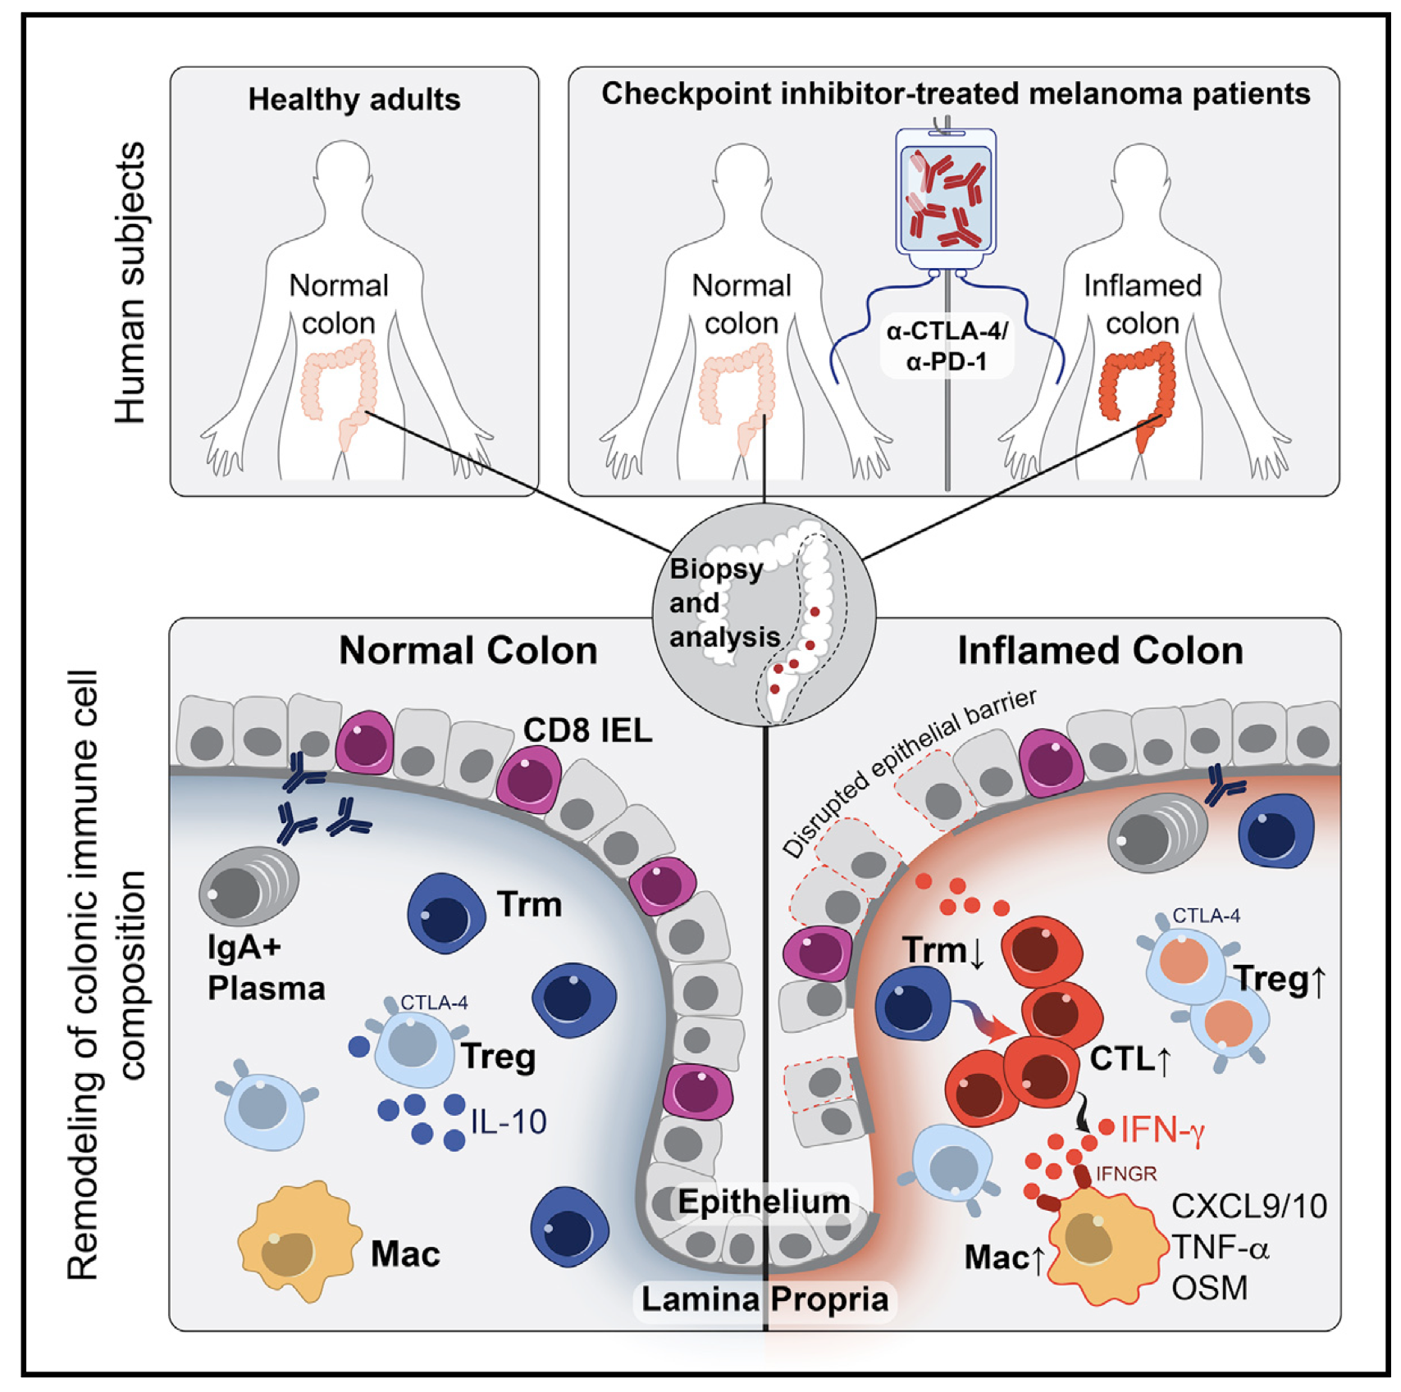
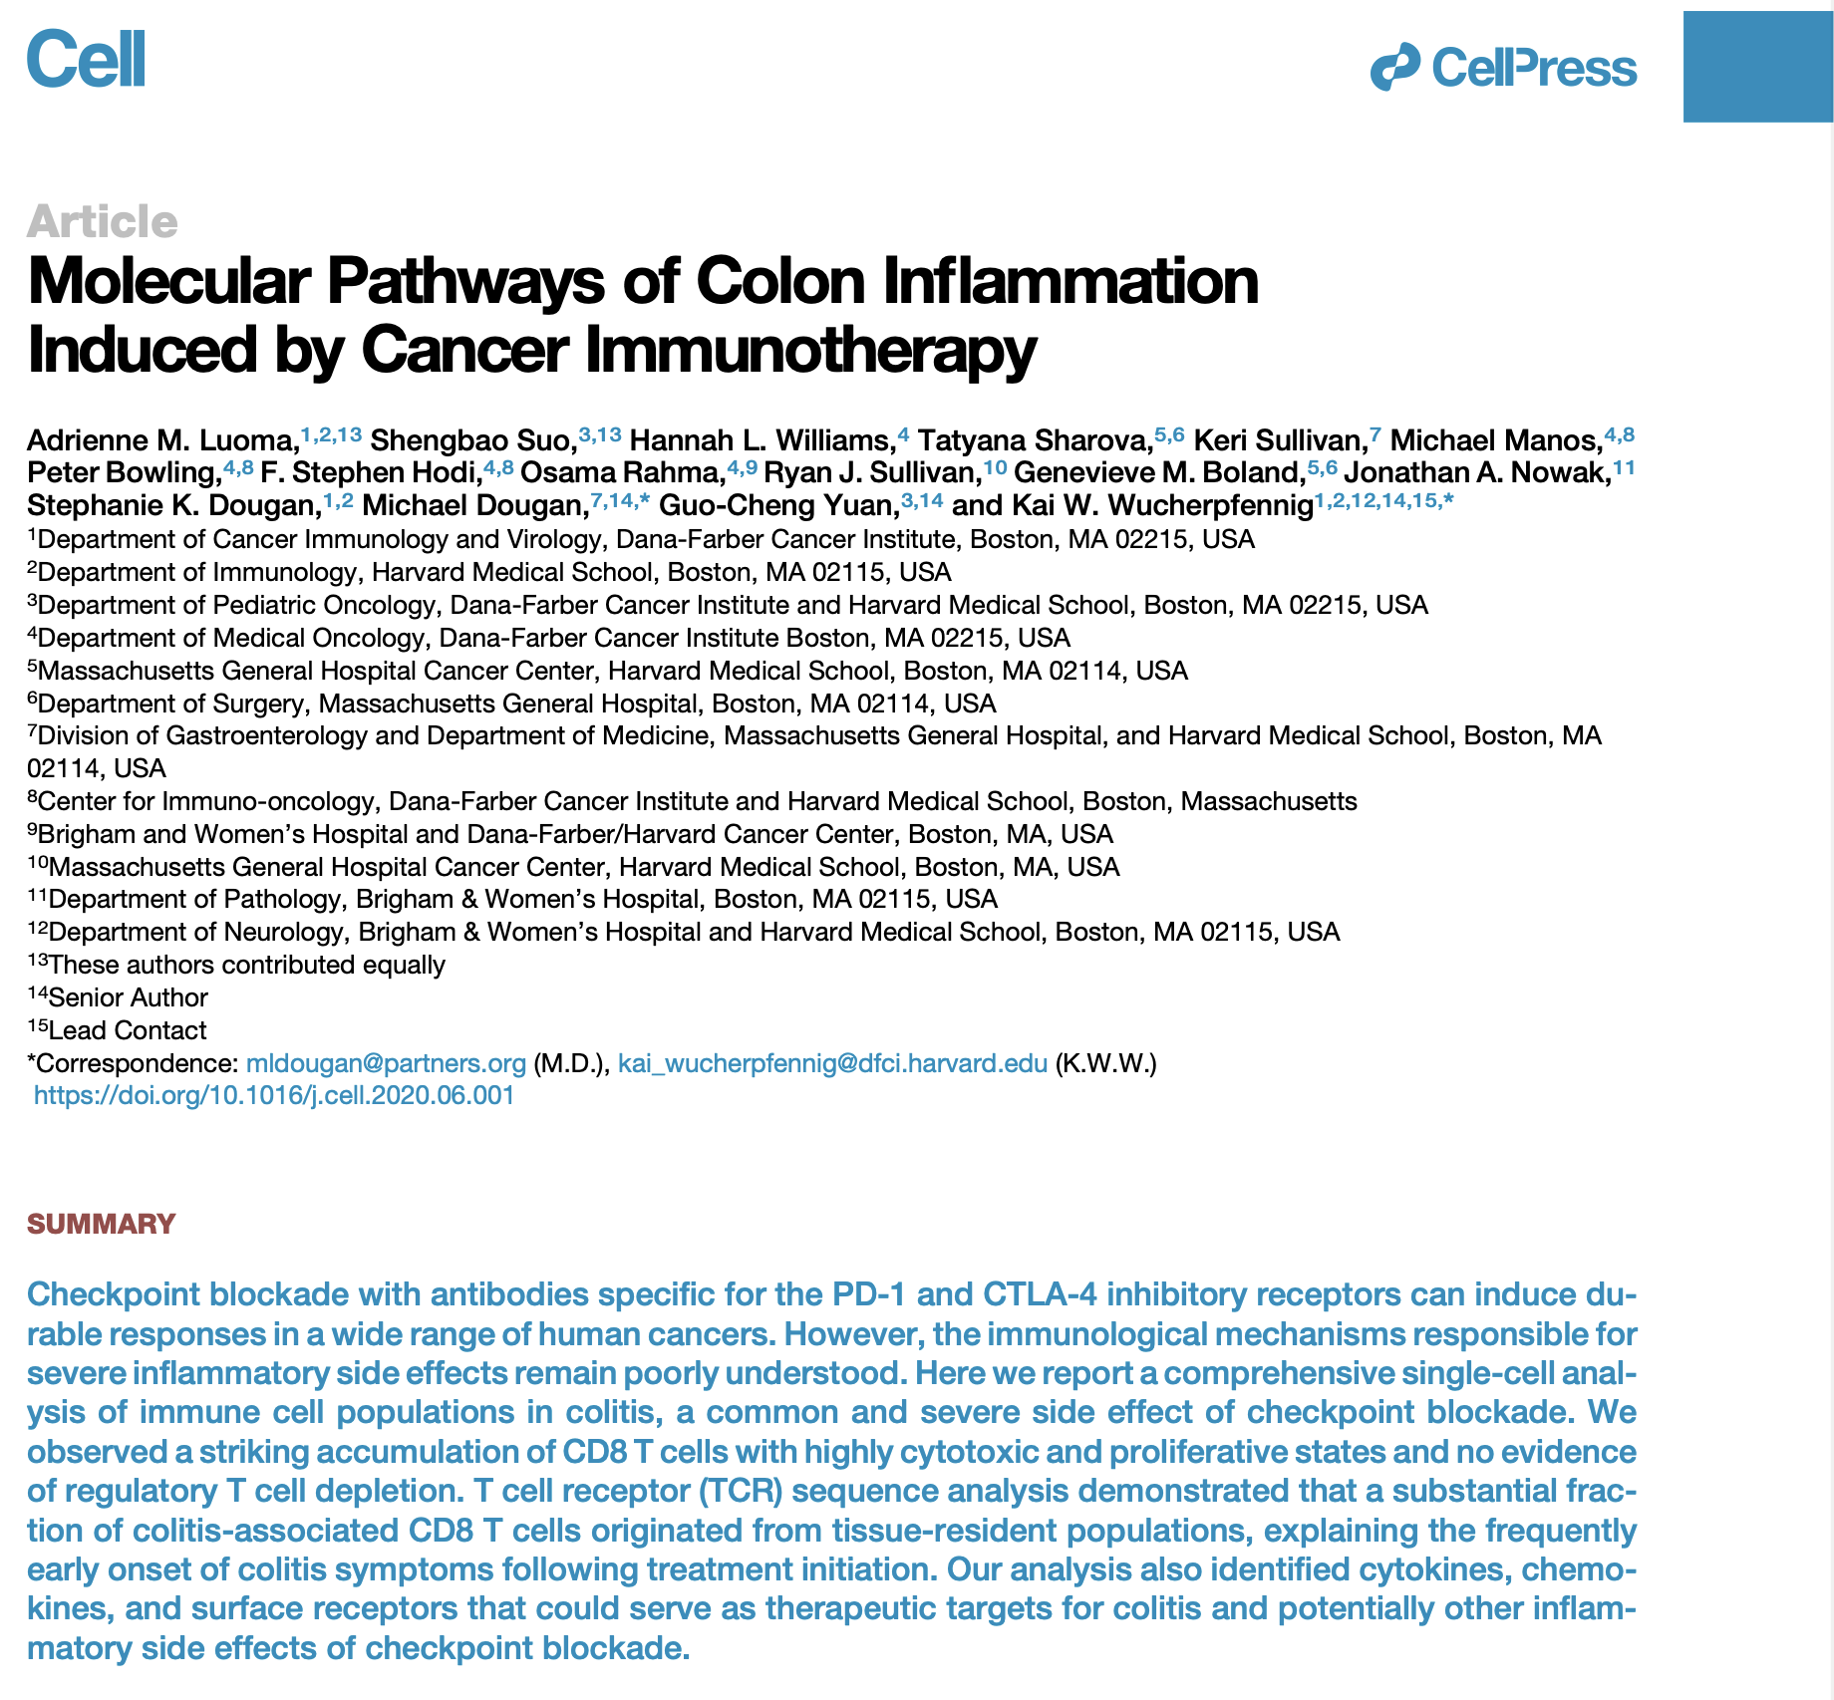
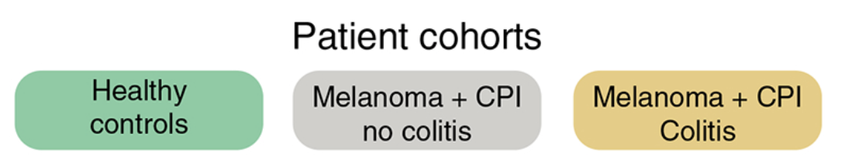
n = 8 n = 6 n = 8
Colon tissue
Notes:
Colitis seq details:
Sequencing of scRNA-seq libraries
CD3⁺ T cell gene expression libraries were sequenced on the Illumina HiSeq 4000 platform with 150 bp paired-end read configuration. CD45+ MNC libraries were sequenced either on the Illumina HiSeq 4000 platform with 150 bp paired-end read configuration or the HisSeq 2500 platform on rapid run mode. We obtained >30,000 reads per cell for all samples, which was particularly important with CD45+ libraries for sufficient sampling of non-immunoglobulin genes given the high plasma B cell count. TCR V(D)J libraries were sequenced on the Illumina MiSeq (V2 flowcell), HiSeq 2500, or HiSeq 4000 platform, all on 150 bp paired-end read configuration.

Slide 15
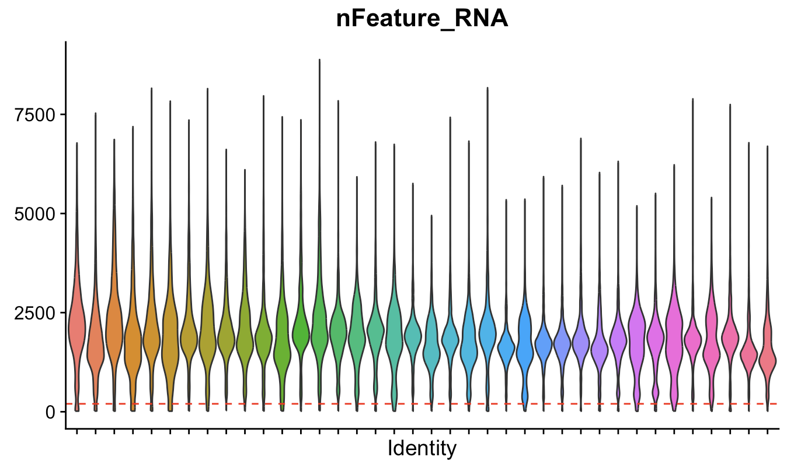
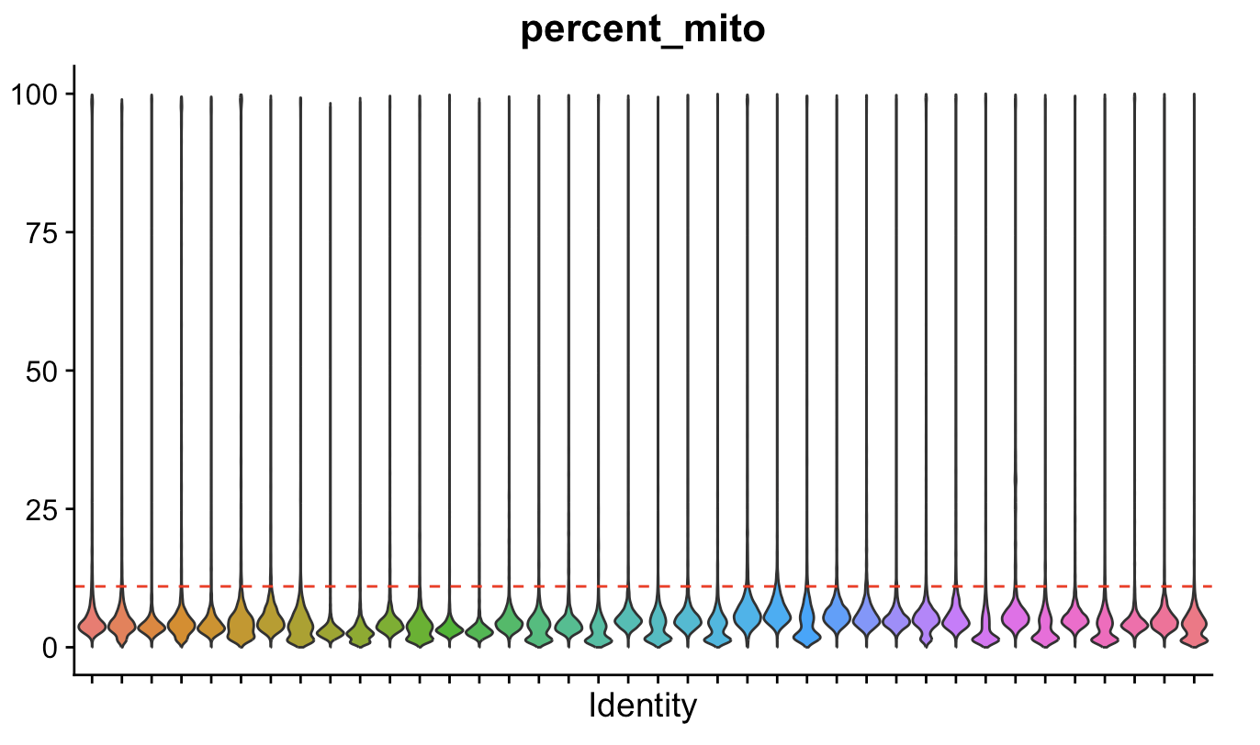
QC (colon tissue colitis dataset)
Patient ID
Patient ID
~129k cells remain after QC (~13k cells dropped),
~180k cells remain after QC (~50k cells dropped) in PBMC myocarditis-focused dataset
Notes:
Colitis: "nFeature_RNA_min" = 200,
"percent_mito" = 11
Myocarditis: mtRNA < 15%
500 unique RNAs/cell

Slide 16
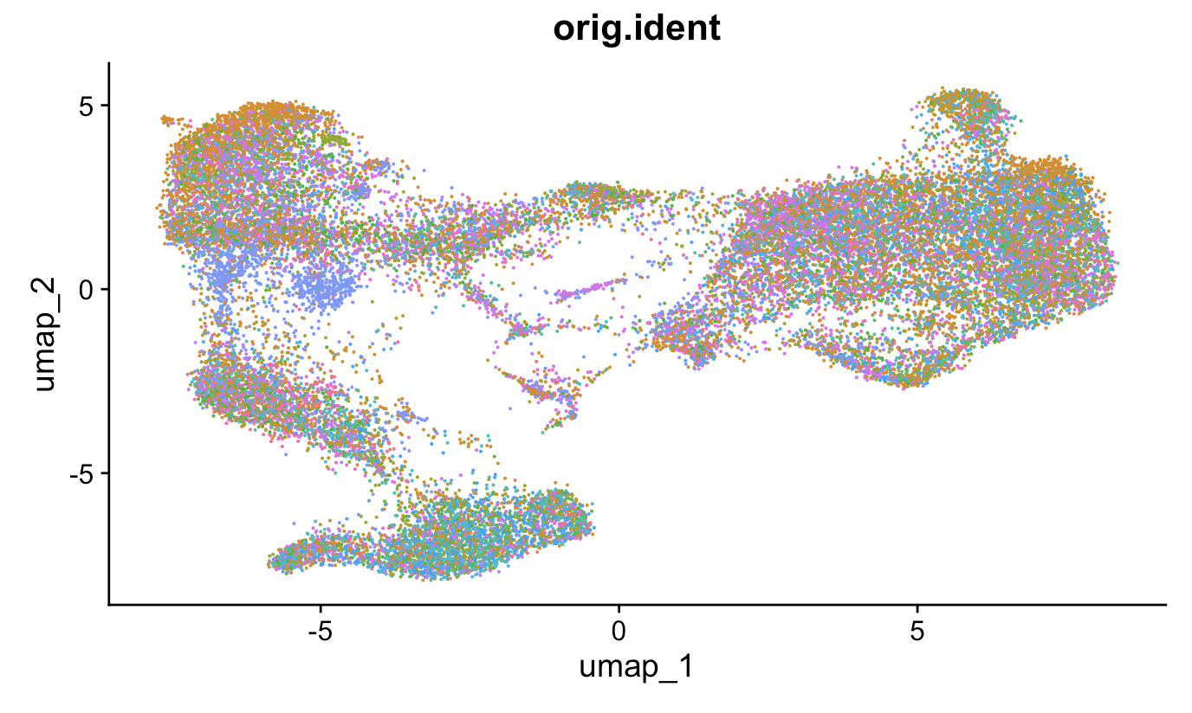
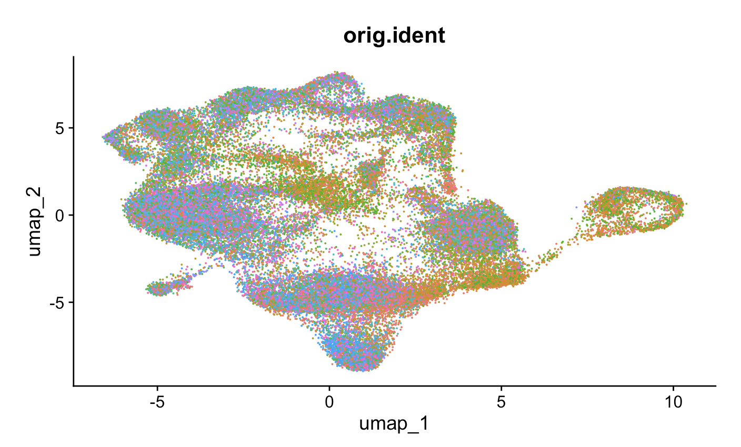
Data normalization, highly variable feature selection, data scaling, dimensional reduction
PBMC myocarditis-focused dataset
Colon tissue colitis dataset
Patient ID
Patient ID

Slide 17
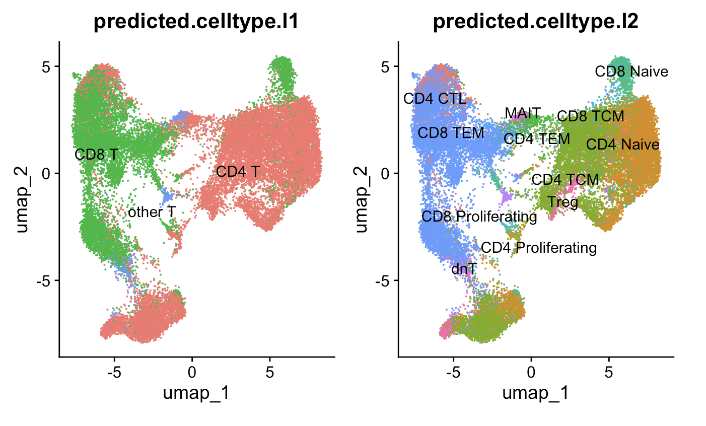
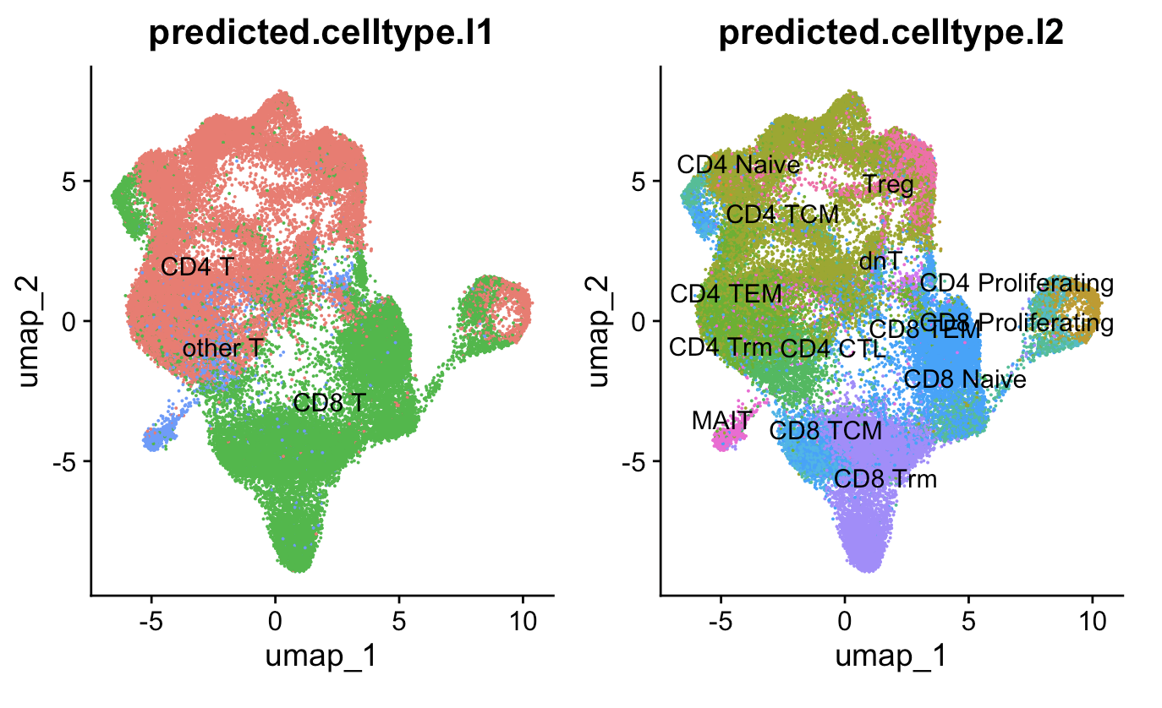
Clustering, reference mapping
PBMC myocarditis-focused dataset (~30k T cells)
Colon tissue colitis dataset (~50k T cells)
Clusters with high CD69 are CD4 Trm,
high CD49a/CD101/CD103 are CD8 Trm

Slide 18
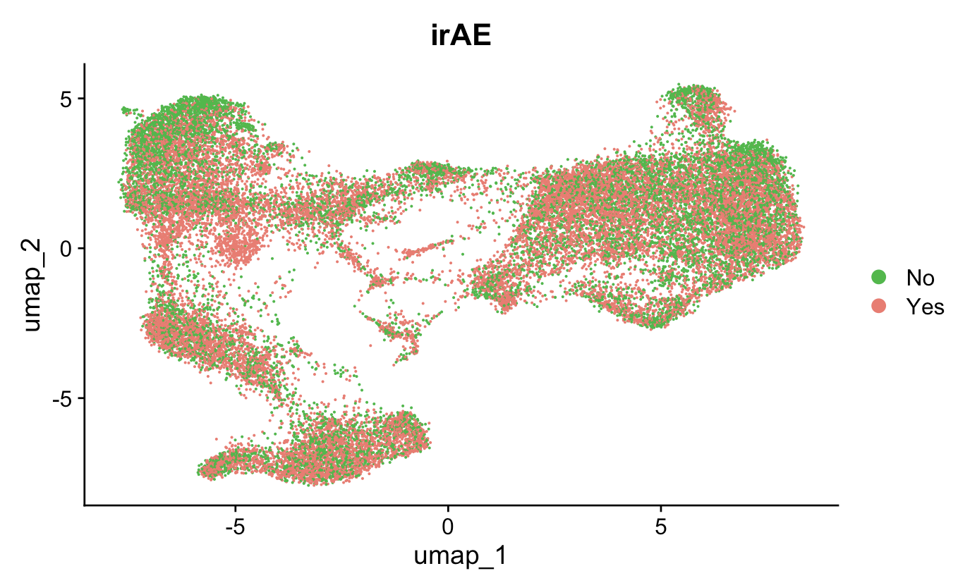
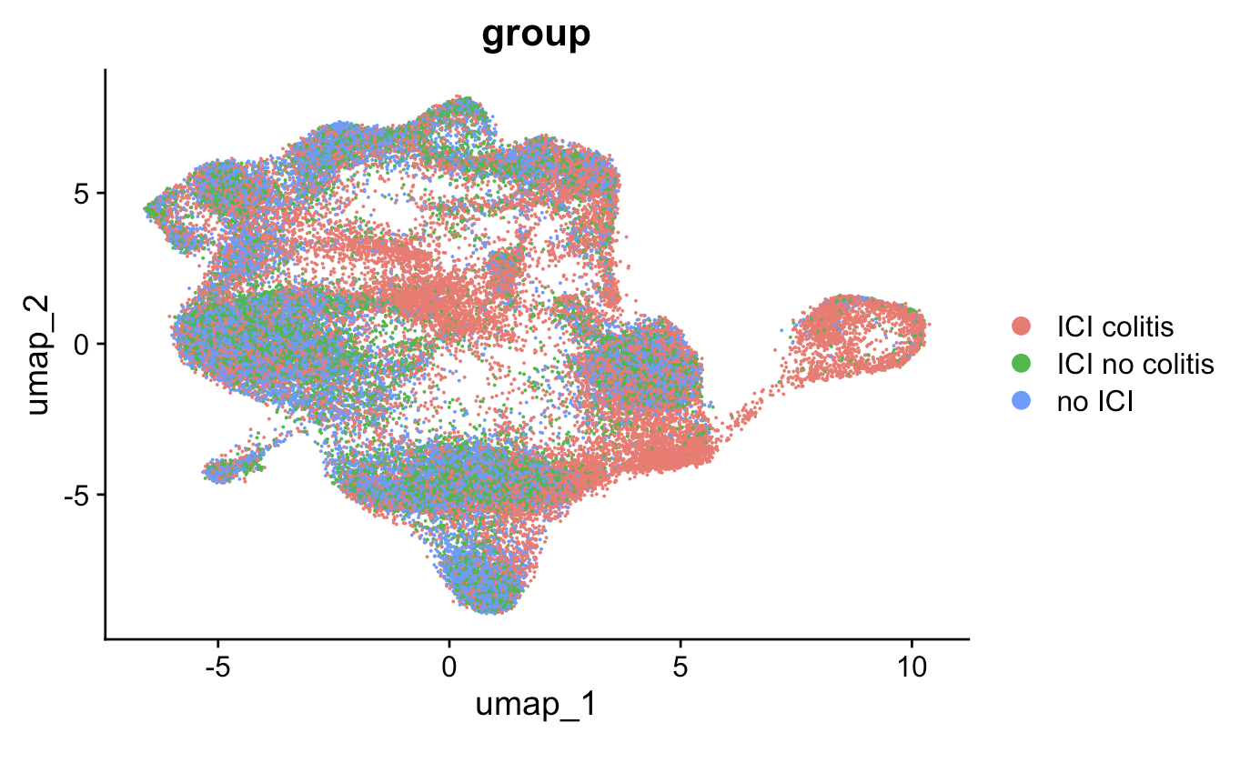
Some cell types seem more abundant in ICI colitis group
PBMC myocarditis-focused dataset
Colon tissue colitis dataset

Slide 19
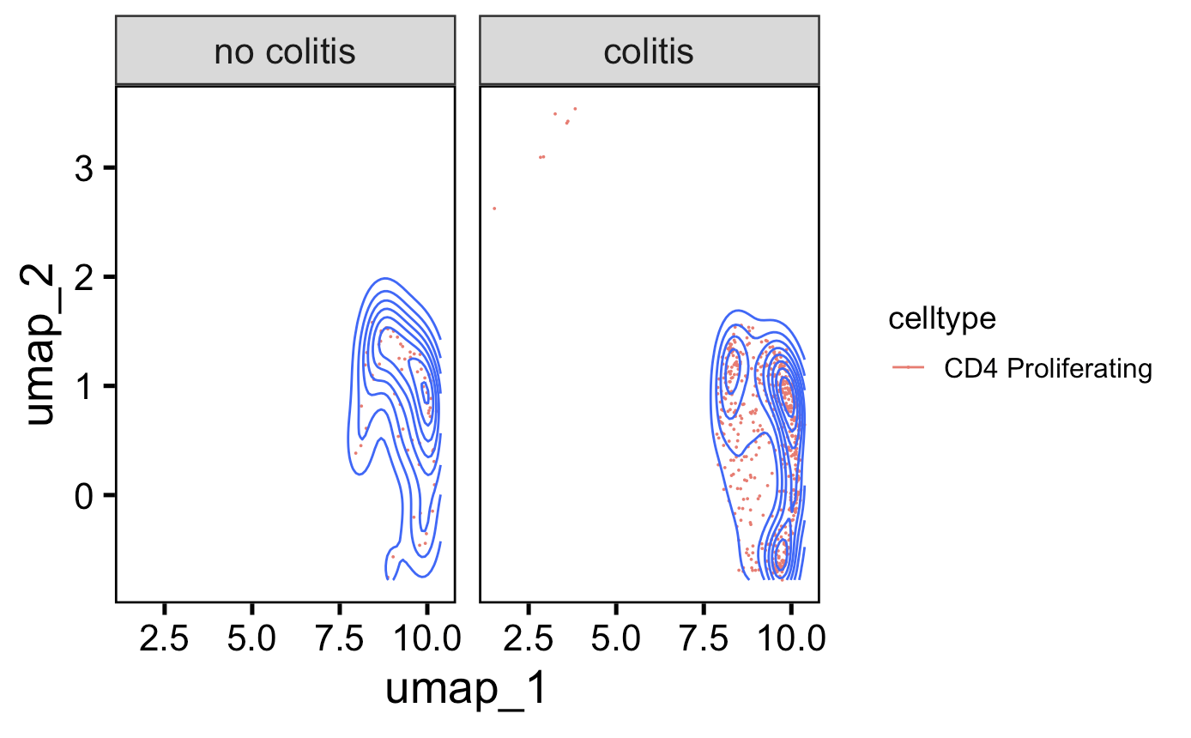
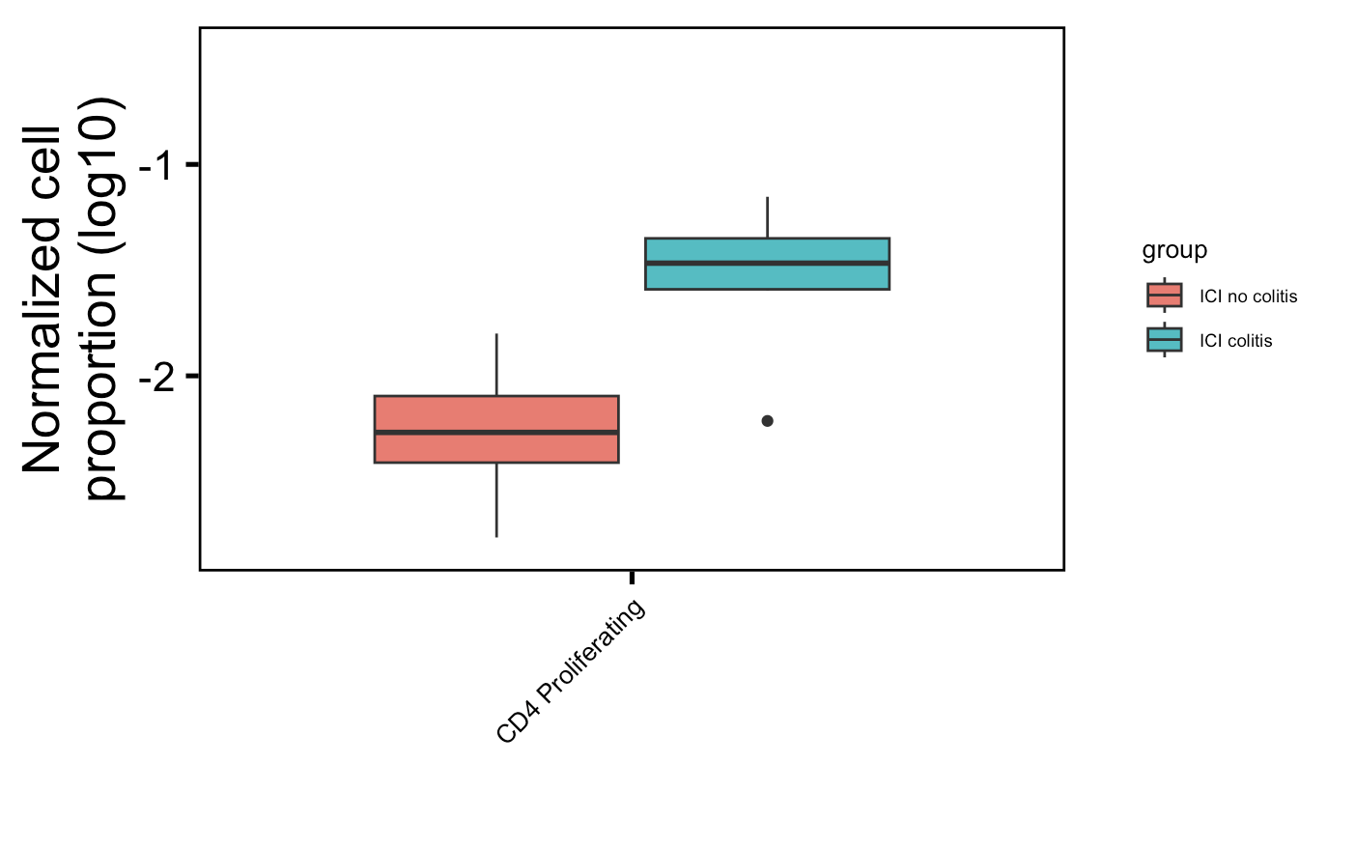
More proliferating CD4 T cells in irAE colitis tissue (also seen in dataset’s published paper)
**
Proliferating CD4 T cells
normalized by patient clonotype depth
downsampled
Wilcoxon rank sum test. **, padj <1e-2
Notes:
Basically not sure how useful this will be for cytometry people as it’s 1) in colon tissue, 2) doesn’t replicate super well with other papers (yes it does with same paper though but…)

Slide 20
Converged TCRs mark antigen exposed T cells and are associated with ICB response (PMID36350695)
Public CDR3 AAs
CDR3 AA present in > 1 patient
Perhaps from germline recombination biases/convergent recombination or TCR convergence
TCR convergence
> 1 CDR3 nt leading to CDR3 AA
Perhaps from selection due to persistent antigen exposure
Notes:
# Sharing of T cell receptors in antigen-specific responses is driven by convergent recombination
- convergent recombination, rather than recombination bias or selection, drives publicity
- potential causes of publicity: self tolerance restricts capacity of TCRs to recognize some epitopes, different conformations of peptides in MHC groove (flat or prominent), degenerate binders
the frequency of random V(D)J recombination events that converge to produce a given nucleotide or amino acid sequence. We term this phenomenon “convergent recombination.”

Slide 21
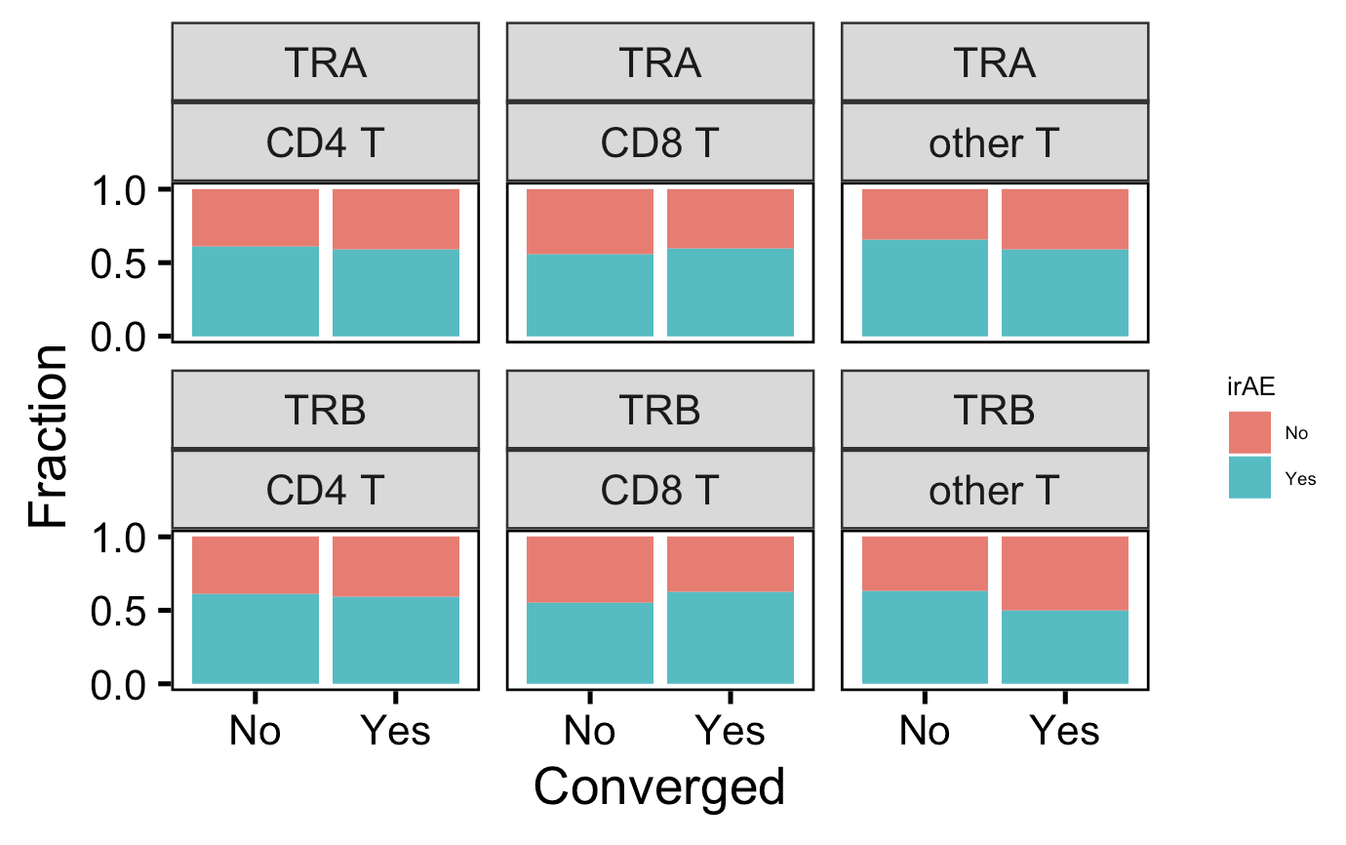
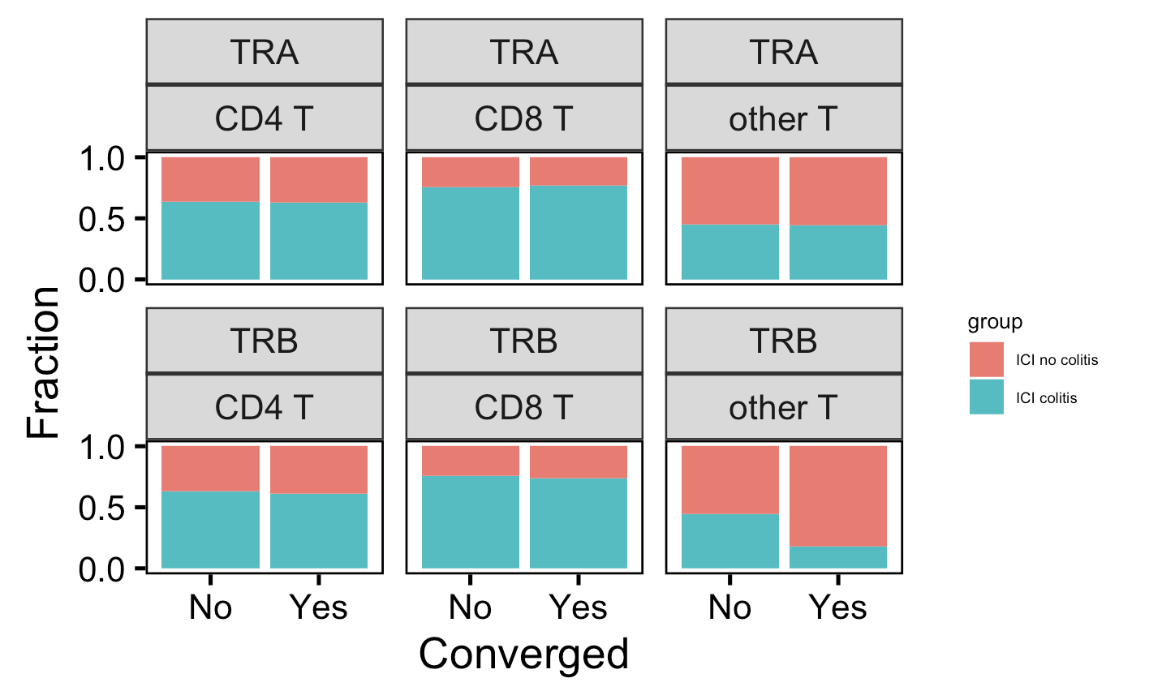
No differences in convergence (nor publicity, privicity, not shown) between irAE groups by chain, cell type
PBMC myocarditis-focused dataset
Colon tissue colitis dataset

Slide 22
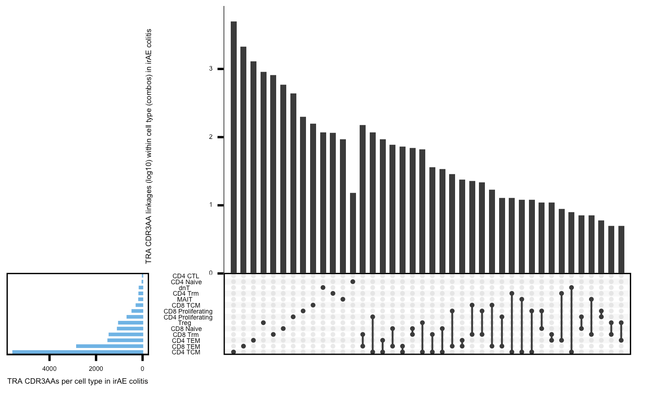
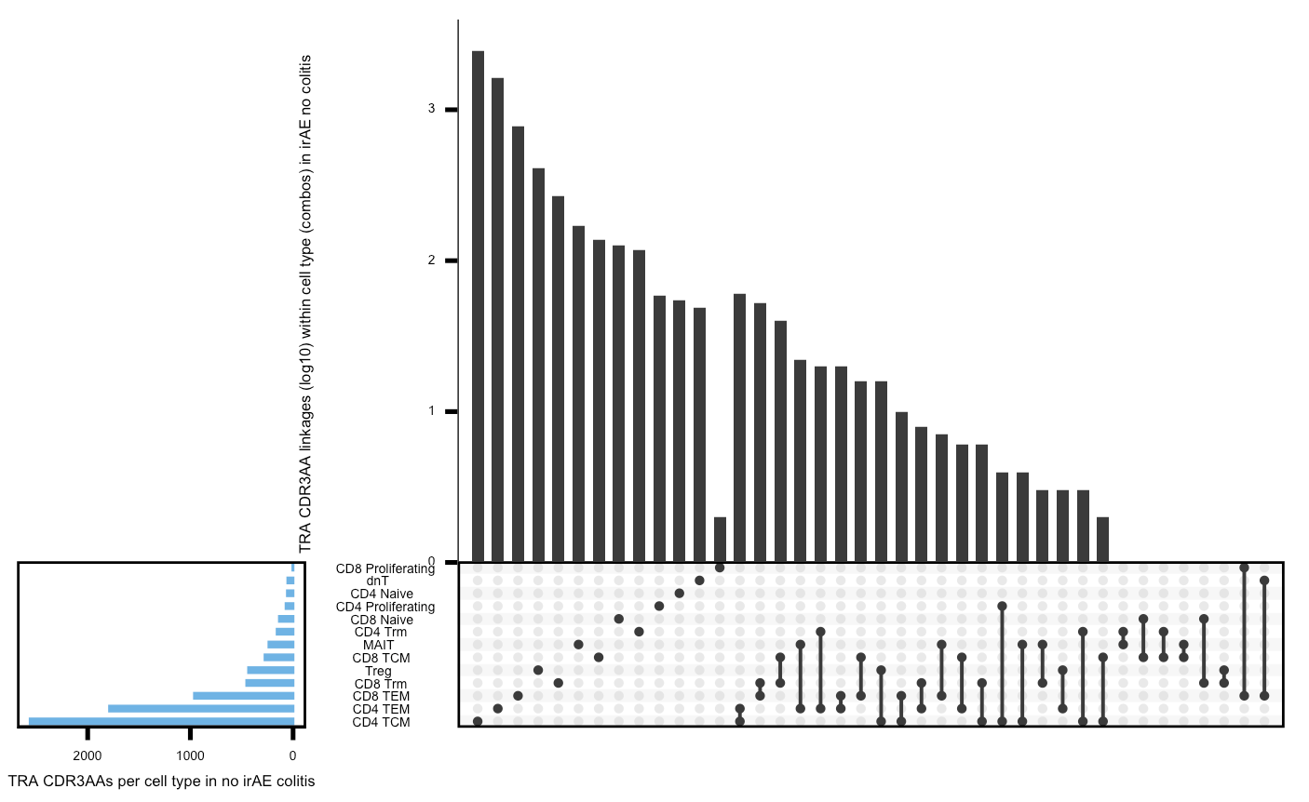
Colon tissue colitis dataset upset plots (TRA): most CDR3 AA linkages are within cell types
Within irAE colitis group
Within no irAE colitis group

Slide 23
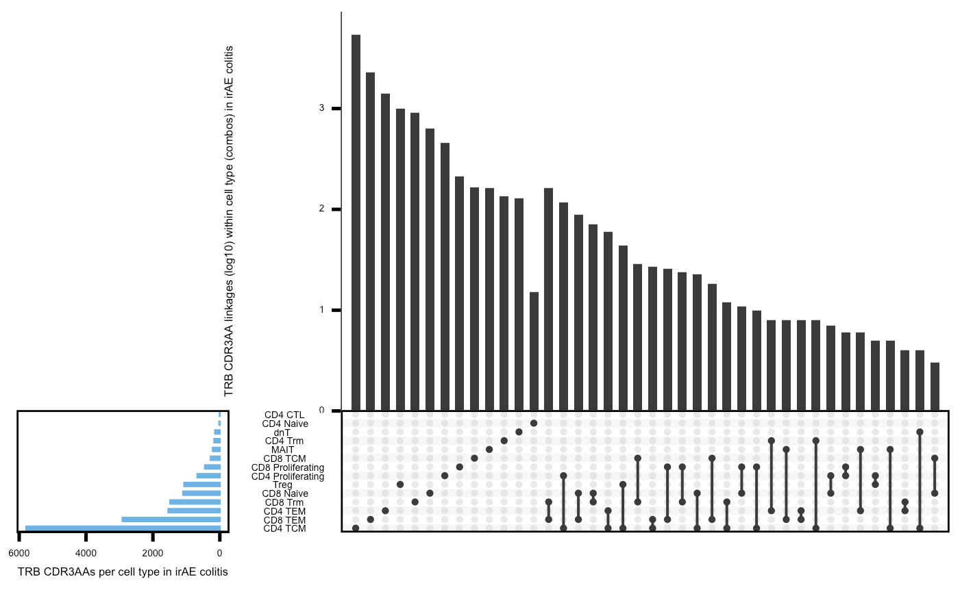
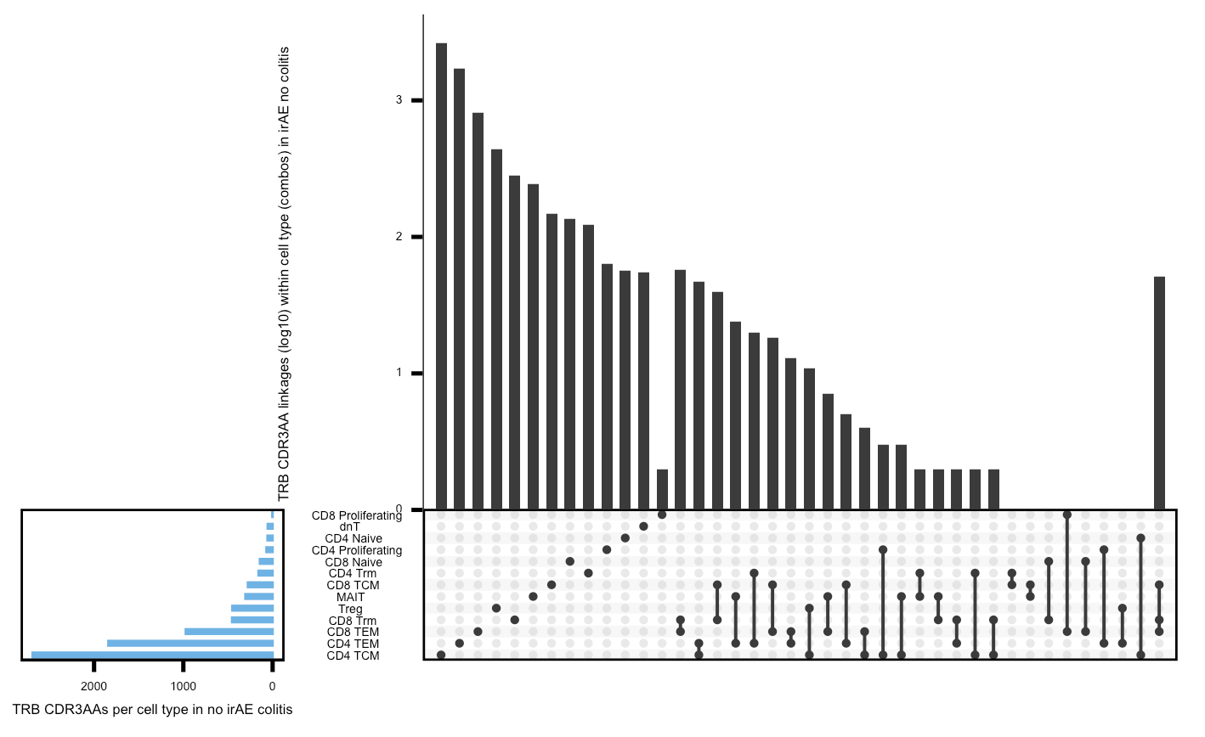
Colon tissue colitis dataset upset plots (TRB) : most CDR3 AA linkages are within cell types
Within irAE colitis group
Within no irAE colitis group

Slide 24
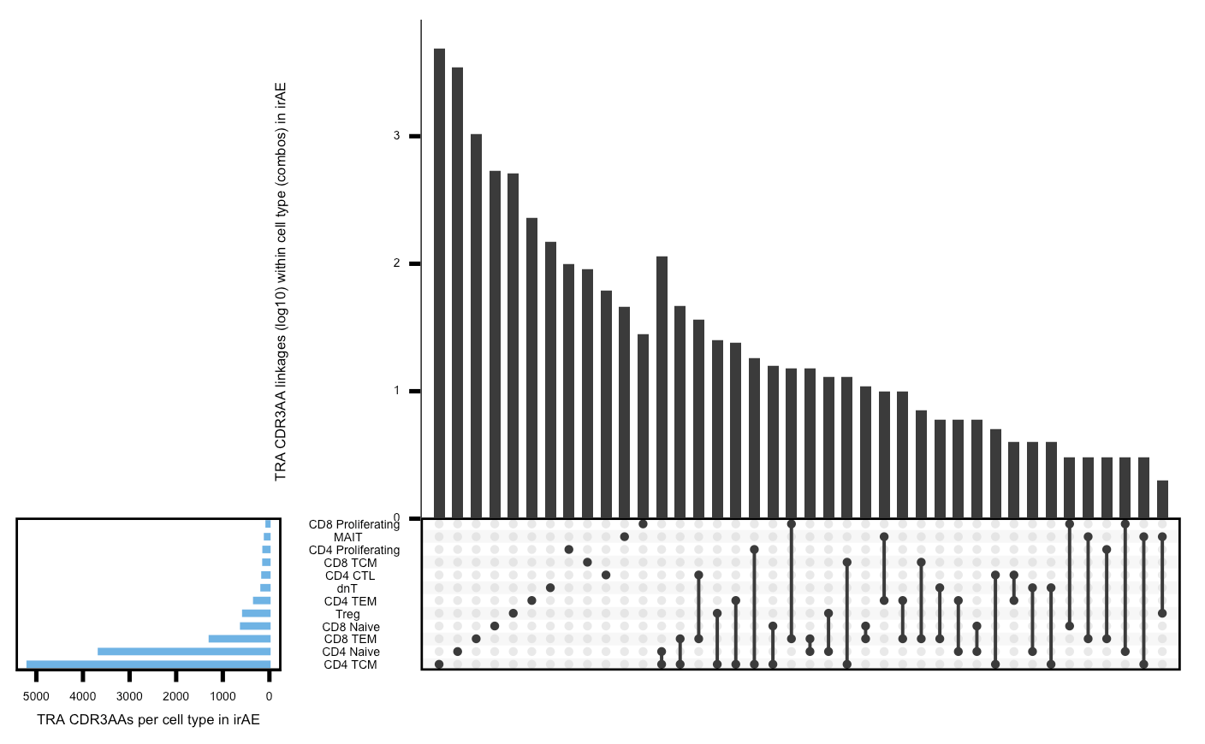
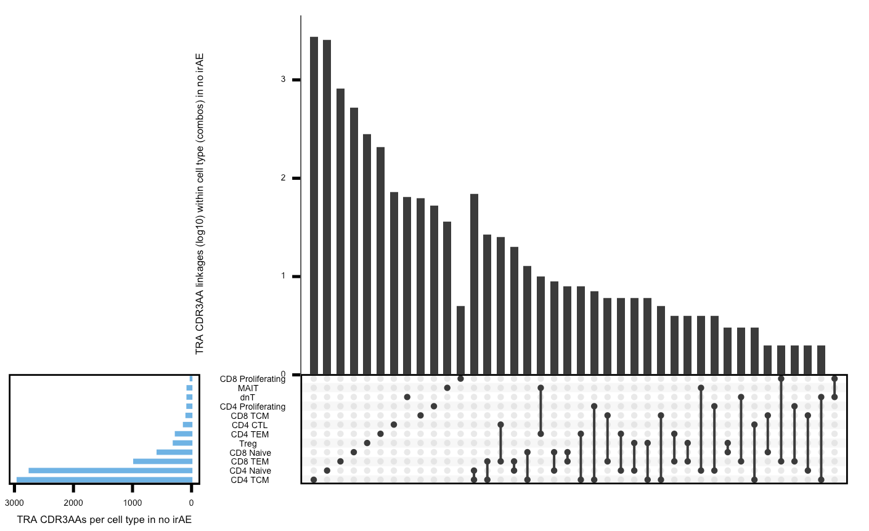
PBMC myocarditis-focused dataset upset plots (TRA) : most CDR3 AA linkages are within cell types
Within irAE group
Within no irAE group

Slide 25
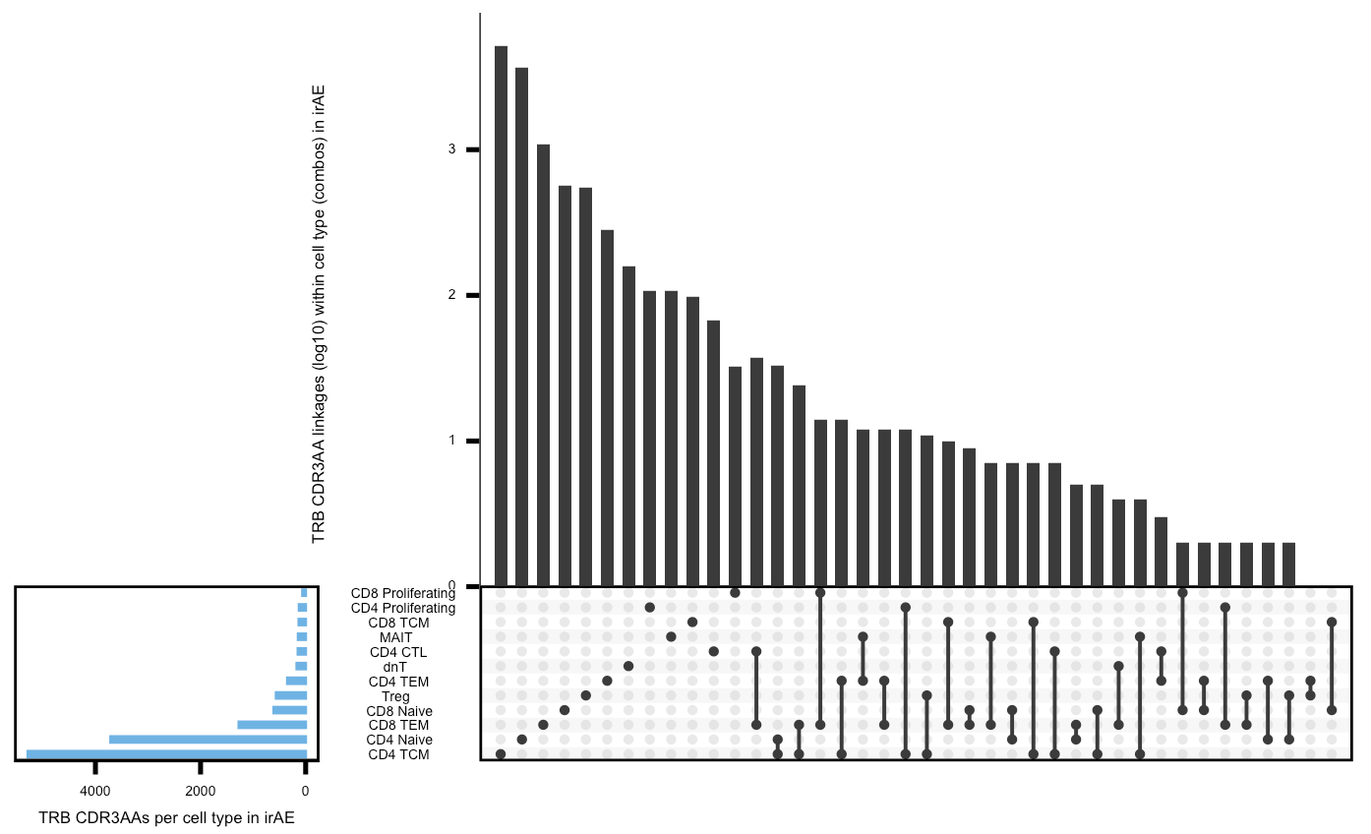
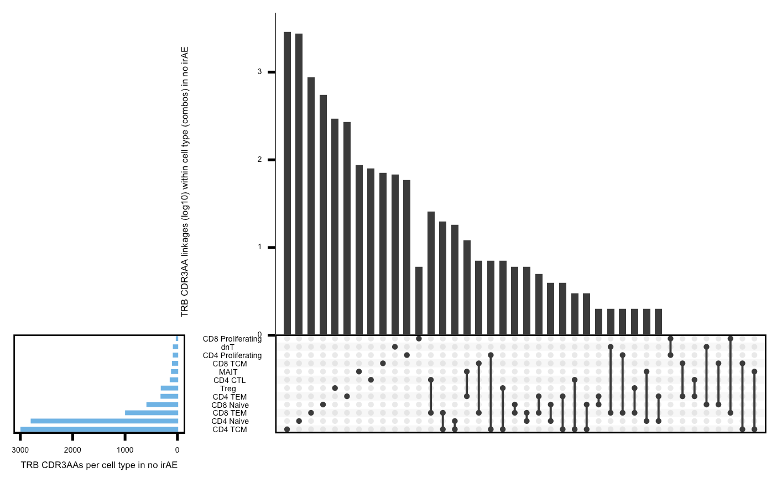
PBMC myocarditis-focused dataset upset plots (TRB) : most CDR3 AA linkages are within cell types
Within irAE group
Within no irAE group

Slide 26
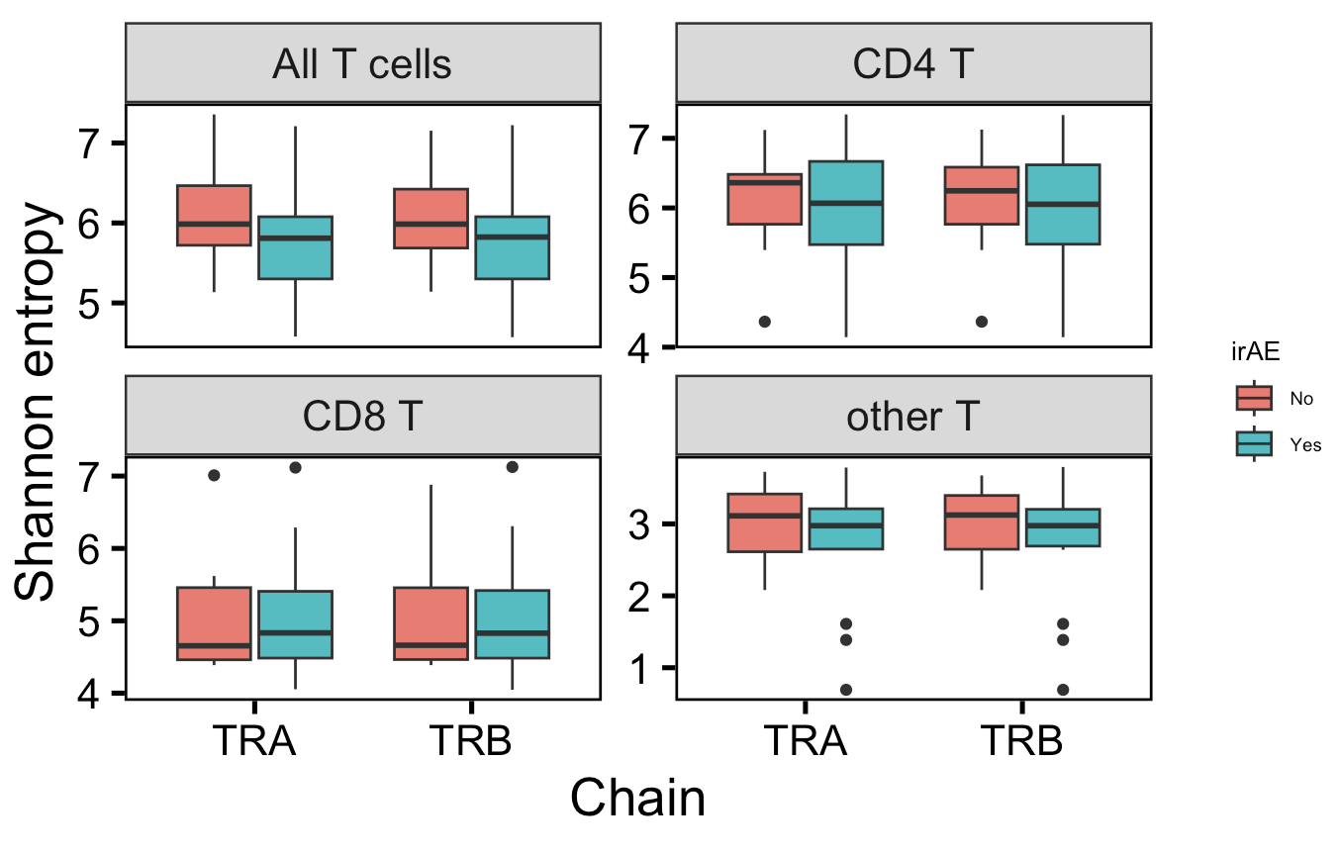
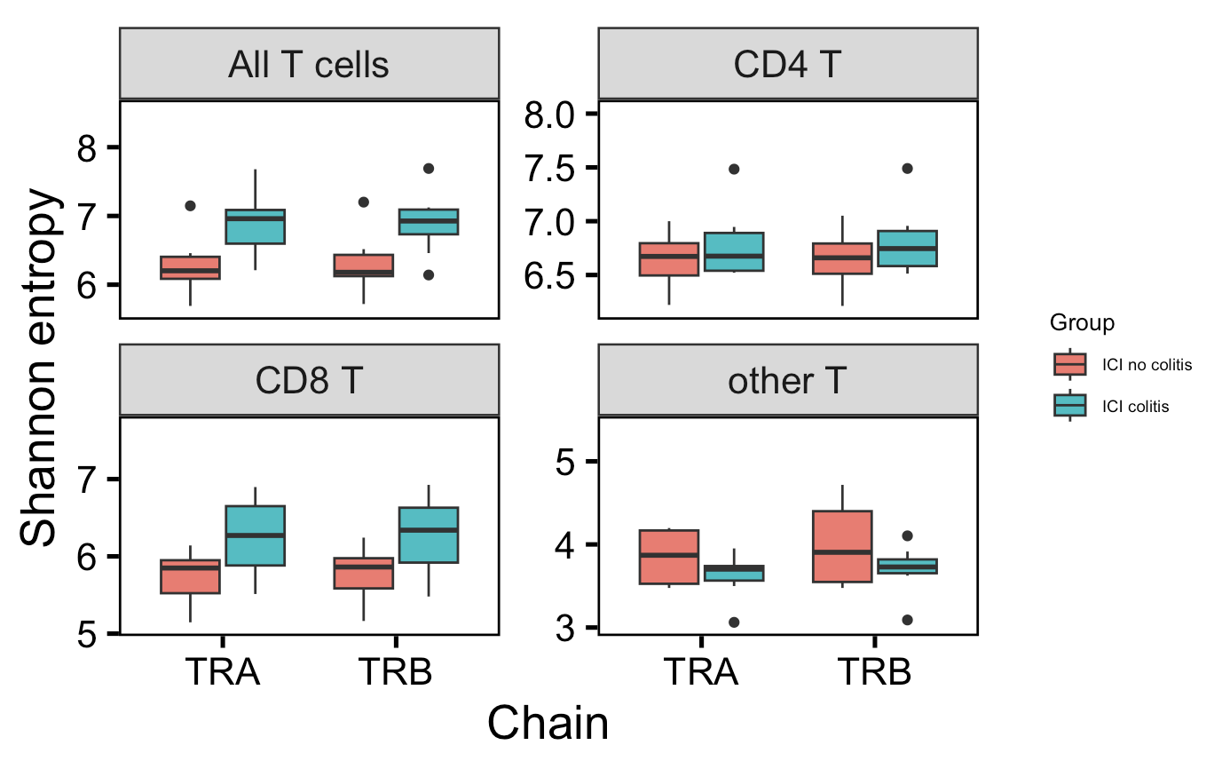
No differences in TCR repertoire diversity between irAE groups
PBMC myocarditis-focused dataset
Colon tissue colitis dataset
Notes:
This is unexpected given literature introduction (T cell expansion/diversity associated with irAE)
# Shannon entropy: 0 means monoclonal, higher means polyclonal, weights richness (total # of unique clones) over evenness

Slide 27
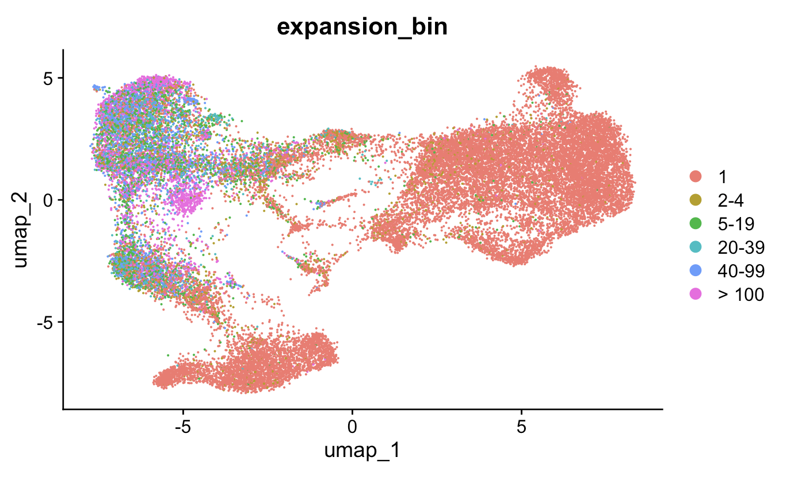
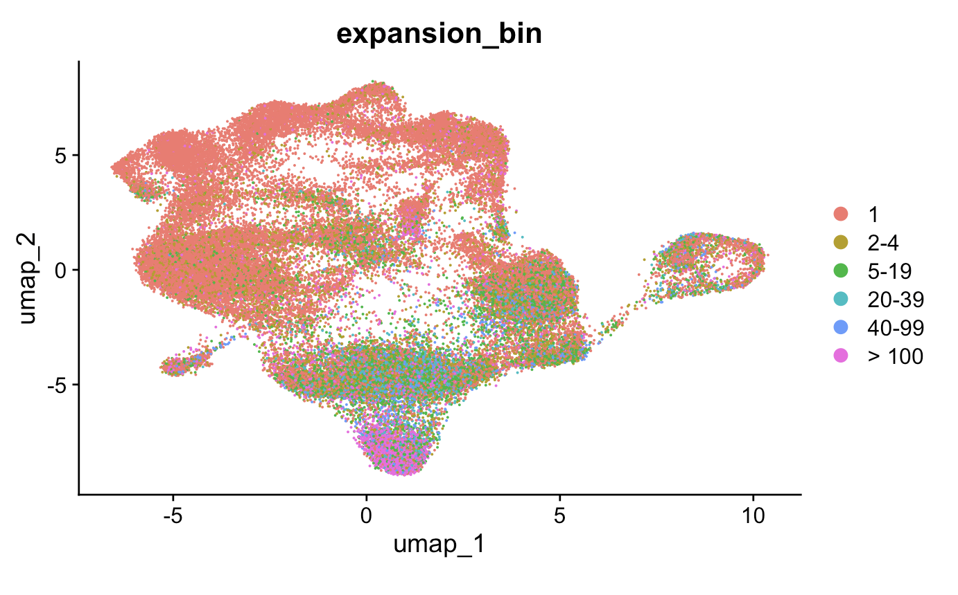
Antigen exposure induces T cell expansion
PBMC myocarditis-focused dataset
Colon tissue colitis dataset

Slide 28
Feature analysis within T cell expansion bins for each cell type
Calculate clonotype (paired chain-CDR3 AA-V-J) counts within each patient
If not downsampling, normalize clonotype counts within each patient by sum of clonotypes for that patient (clonotype depth)
Slice to only look at unique clonotypes from each patient
Arrange by (normalized if not downsampled) clonotype counts within cell type, chain groups
Create 20 bins per cell type, chain group, i.e. bin 1 is top 5% expanded clonotypes for that chain-cell type across patients, bin 2 is top 10%...
Perform Wilcox rank sum test up to each bin for each cell type, chain group for features of interest
Use Stitchr package (PMID35325179) to produce TCR sequences from VJ and CDR3 sequences
CDR3 length/hydrophobicity and TCR probability of generation (pgen, PMID29422654) analyses for unique TCRs within T cell expansion bins for each cell type
Create heatmaps of –log10(padj value) by cell type, chain, feature groups across % repertoire bins
Notes:
Stitchr: basically looks for sequence matches between N terminus and C terminus of junction and V gene, incrementally deleting V gene residues until it finds junction. Then use non-V portion of CDR3 to search J gene, then remainder for search D gene (TRB). Then get seq by trim reference and use most common codon for species
IGoR: IGoR starts by listing the possible recombination and hypermutation scenarios leading to an observed sequence in the data set, then assigns probability weights reflecting the likelihood of these scenarios, IGoR restricts its exploration to the reasonably likely ones to save on computational cost
computational pipeline: V(D)J recombination proceeds by joining randomly selected segments (V, D, and J segments in the case of TRB and IGH), each segment gets trimmed at its ends (hashed areas), and a varying number of non-templated insertions are added between them, IGoR lists putative recombination scenarios consistent with the observed sequence, and weighs them according to their likelihood, the likelihood of each scenario is computed using a Bayesian network of dependencies between the recombination features (V, D, J segment choices, insertions, and deletions)

Slide 29
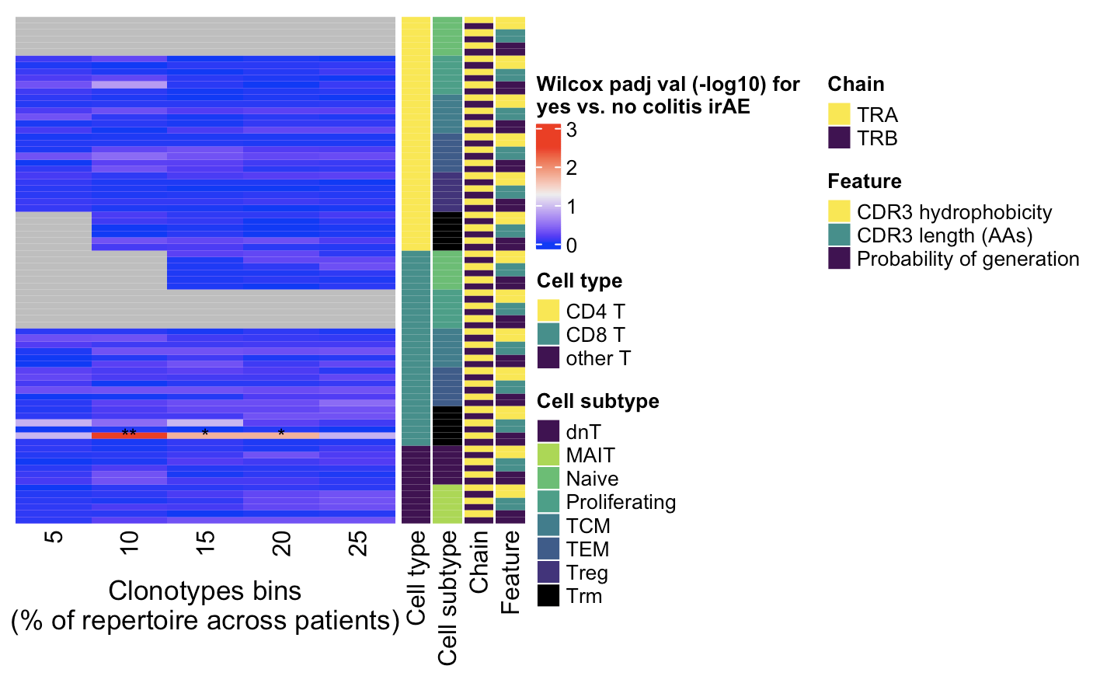
Some colon tissue colitis dataset features between irAE groups may be different among chain, cell type combos (none are different if downsampled)
← Higher expansion
Wilcoxon rank sum test. **, padj <1e-2; *; padj <0.05
Notes:
Cumulative binning!
only a small portion of an antigen is needed to be recognized by a TCR (8-10 amino acids for MHCI, 14-18 for MHCII, does this mean that CD8<sup>+</sup> T cells might be more cross-reactive?)
T cell repertoire analysis and metrics of diversity and clonality
CDR1-2 contact MHC and CDR3 contacts peptide is the general rule, but CDR1α also contacts peptide and CDR3β doesn't contact peptide too much
The length of the CDR3 loop greatly influences its shape and ability to fold both on itself and in the company of others loops such as the CDR1 and CDR2 (Davis et al., 1998, Wu et al., 2002): https://www.sciencedirect.com/science/article/pii/S0161589006002148?via%3Dihub

Slide 30
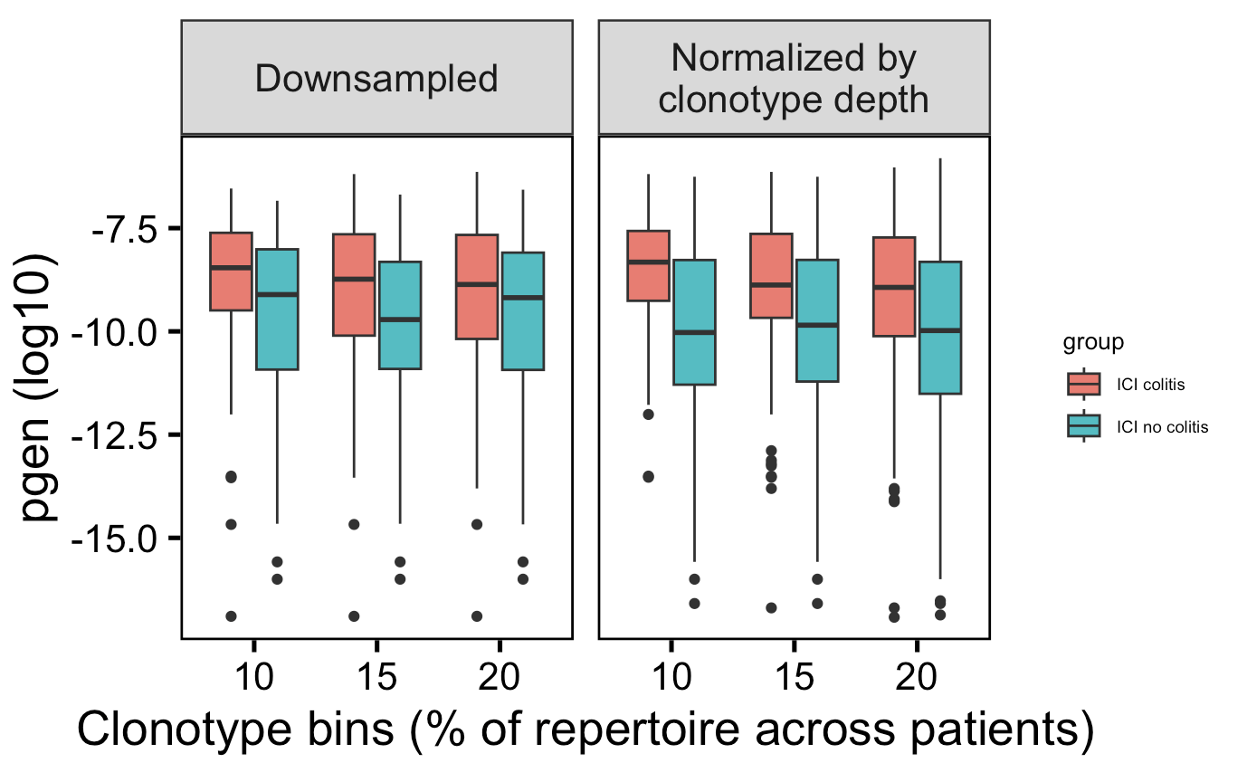
Highly expanded CD8 Trms may have more germline-like TRAs in those developing colitis
**
*
*
→
More germline-like
Less germline-like
→
52 clonotypes/bin
80 clonotypes/bin
Wilcoxon rank sum test. **, padj <1e-2; *; padj <0.05
Notes:
Context of BRI/VDJdb data…
Public/shorter CD8 TRAs/higher pgen expected more crossreactive from BRI/VDJdb data... (VDJdb not pgen, BRI all 3)
Cumulative binning
only a small portion of an antigen is needed to be recognized by a TCR (8-10 amino acids for MHCI, 14-18 for MHCII, does this mean that CD8<sup>+</sup> T cells might be more cross-reactive?)
T cell repertoire analysis and metrics of diversity and clonality
CDR1-2 contact MHC and CDR3 contacts peptide is the general rule, but CDR1α also contacts peptide and CDR3β doesn't contact peptide too much
The length of the CDR3 loop greatly influences its shape and ability to fold both on itself and in the company of others loops such as the CDR1 and CDR2 (Davis et al., 1998, Wu et al., 2002): https://www.sciencedirect.com/science/article/pii/S0161589006002148?via%3Dihub

Slide 31
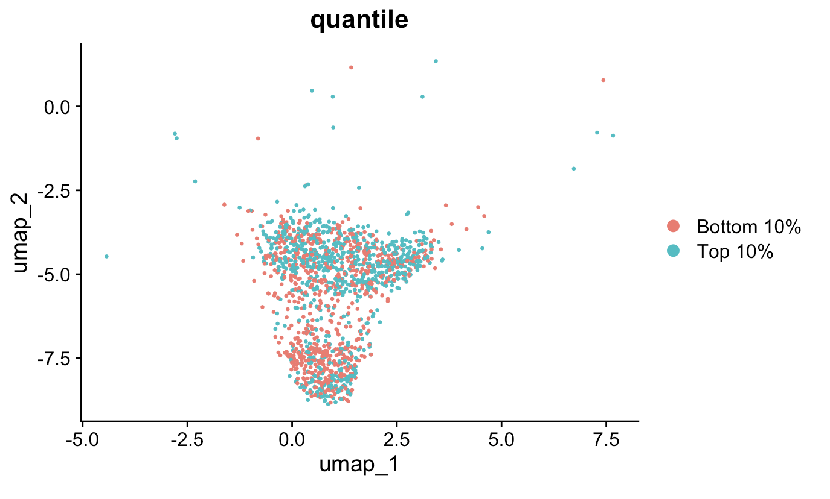
Highest and lowest CD8 Trm TRA pgen cells do not have distinct transcriptional phenotypes
Notes:
No padj < 0.05 (or anywhere close) after pseudobulk analysis
Top and bot here are for pgen (log10), so top here is most germline-like and bot is least germline-like
- perhaps ICB reinvigorates T<sub>RM</sub> cells and patients with more crossreactive Trms get irAEs

Slide 32
Negative results summary
No differences in convergence, publicity (data not shown), privicity (data not shown) between irAE groups by chain, cell type
No differences in TCR repertoire diversity between irAE groups by chain, cell type (unlike seen in literature)
No differences in VJ gene usage between irAE groups (data not shown)
Highest and lowest CD8 Trm TRA pgen cells do not have distinct transcriptional phenotypes

Slide 33
Indeterminate results summary
Highly expanded CD8 Trms may have more germline-like TRAs in those developing colitis
Notes:
perhaps hinting at a connection between germline-ness and crossreactivity
Context of BRI/VDJdb data…
Public/shorter CD8 TRAs/higher pgen expected more crossreactive from BRI/VDJdb data... (VDJdb not pgen, BRI all 3)

Slide 34
Positive results summary
More proliferating CD4 T cells in irAE colitis tissue (also seen in dataset’s published paper)
Some public/private TCR subgroups show distinct TCR features between irAE groups (data not shown)
Colon tissue colitis dataset
Private CD8 TEM TRB pgen and CDR3 length
All CD4 proliferating TRB pgen
PBMC myocarditis-focused dataset
Public CD8 Naïve TRB pgen
Private CD4 TEM TRA pgen
Private Treg TRA CDR3 length
We can mine public data and use it in tandem with BRI data, for example using one as a training set and the other as a test set
Increased confidence in conclusions that are recapitulated across multiple datasets
Increased breadth of possible research questions to investigate
Notes:
Identification of neoantigens for individualized cancer immunotherapy
cross-reactivity is possible due to low affinity of functional TCR-pMHC interaction
Lack of necessity for super high affinity TCR-pMHC may support more alternative contacts ~= more crossreactive hypothesis (i.e. longer CDR3 may disrupt peak affinity but may allow more possible ok TCR-pMHC interactions sufficient to induce T cell activation)
Context of BRI/VDJdb data…
Public/shorter CD8 TRAs/higher pgen expected more crossreactive from BRI/VDJdb data... (VDJdb not pgen, BRI all 3)

Slide 35
Next steps
Look for genes whose expression correlates with pgen in CD8 Trms
Linkage analysis
Look for TCRs shared across datasets
Compare TCR features between linkage groups

Slide 36

Acknowledgements
Add funding
Peter Linsley
Datasets
Colon tissue colitis: Luoma et al. Cell. 2020
PBMC myocarditis-focused: Zhu et al. Circulation. 2022
Bioinformatics group
Alex Hu
Erin Witkop
Matt Dufort
Matt Lawrence
Hannah DeBerg
Thomas Edwards
Tomasz Janczyk

Slide 37
Extra slides

Slide 38
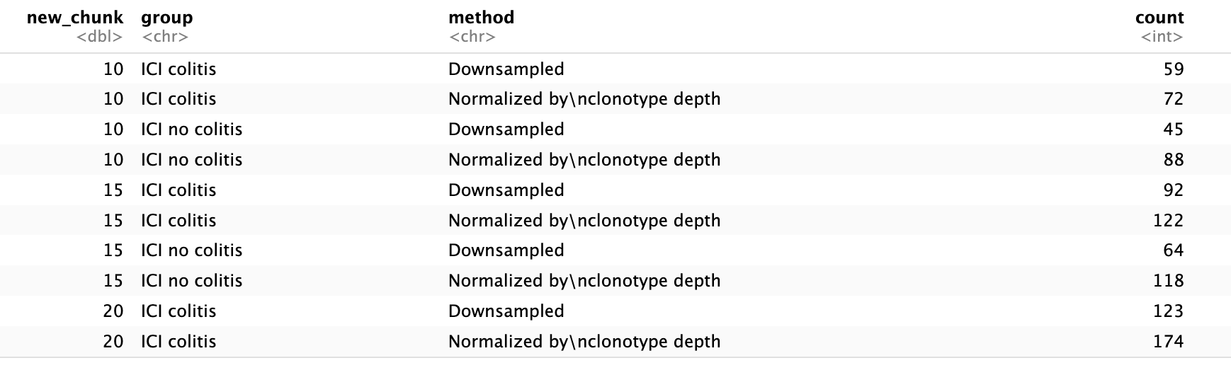
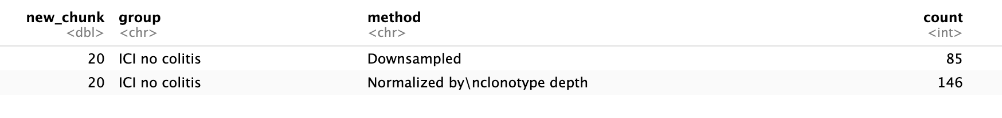
Numbers of clonotypes within clonotype bins, groups, methods for CD8 Trm TRA pgen effect
Notes:
80 clonotypes/bin (not downsampled), 52 clonos/bin if downsampled

Slide 39
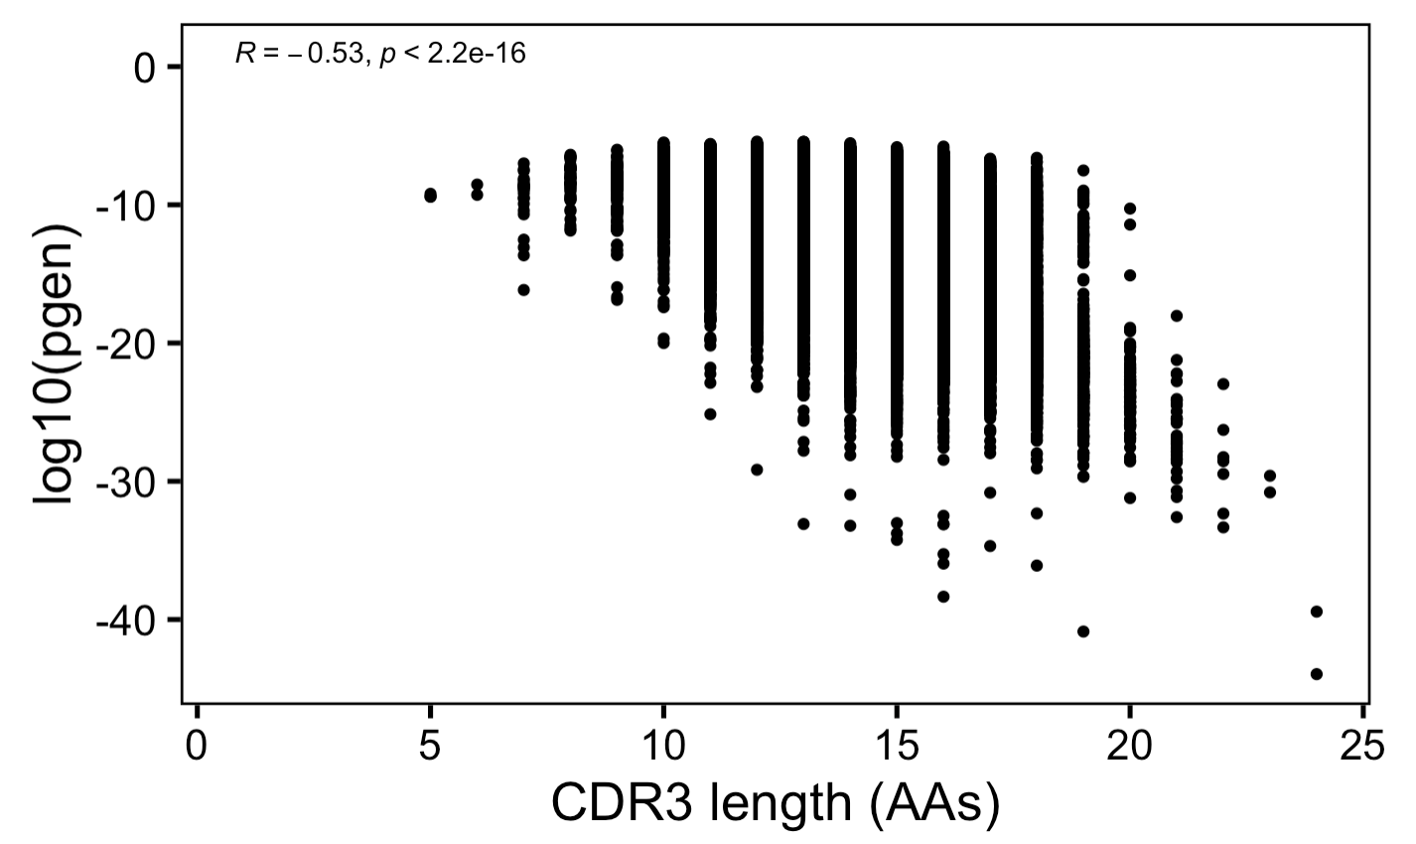
Anticorrelation between CDR3 length and germline-ness
→
More germline-like
Less germline-like
→

Slide 40
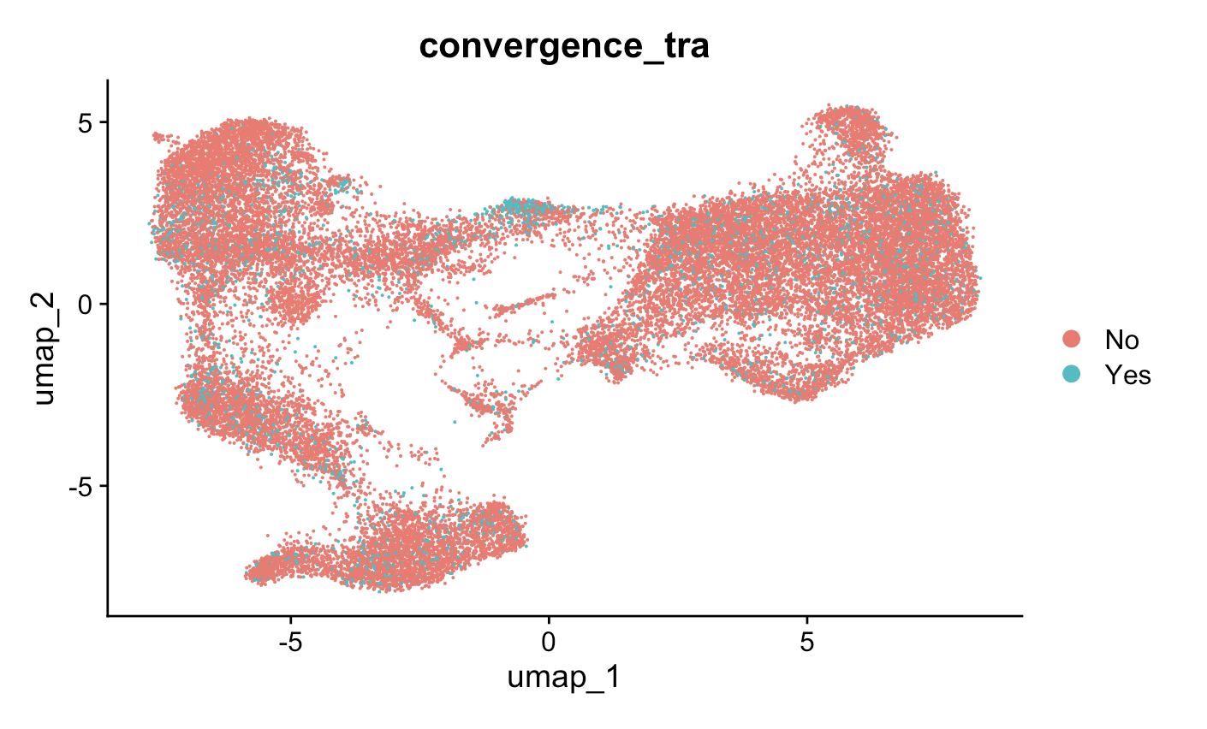
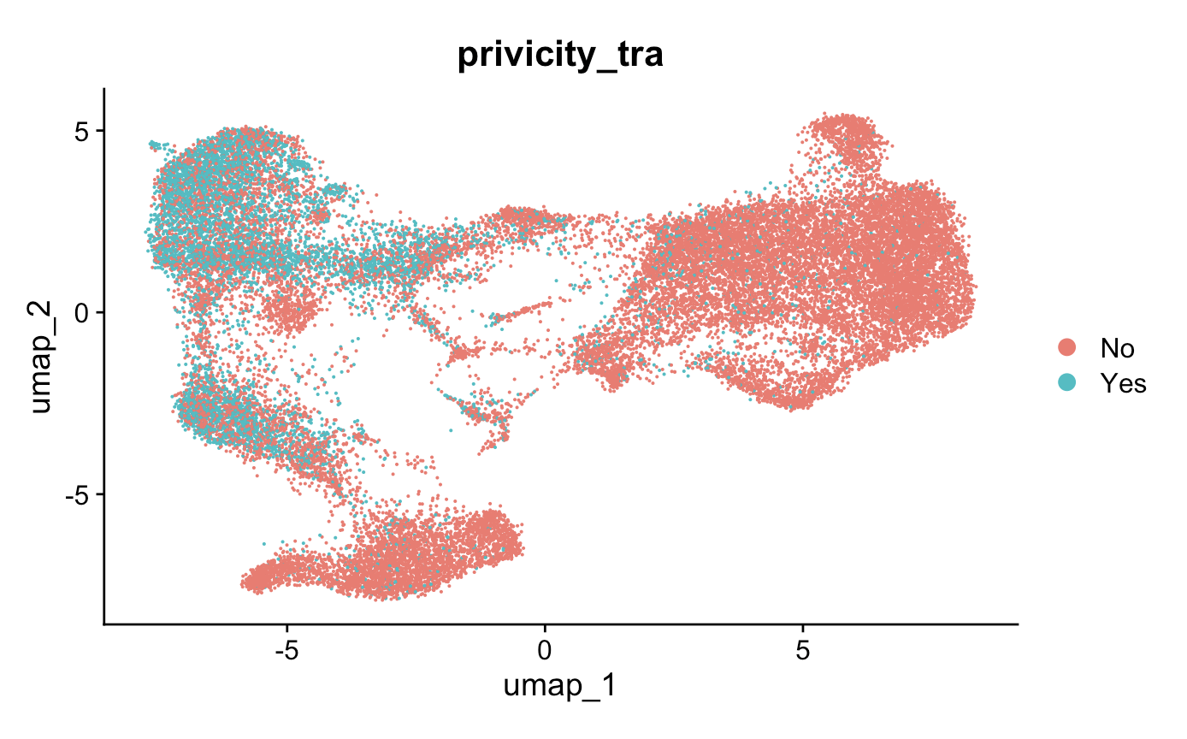
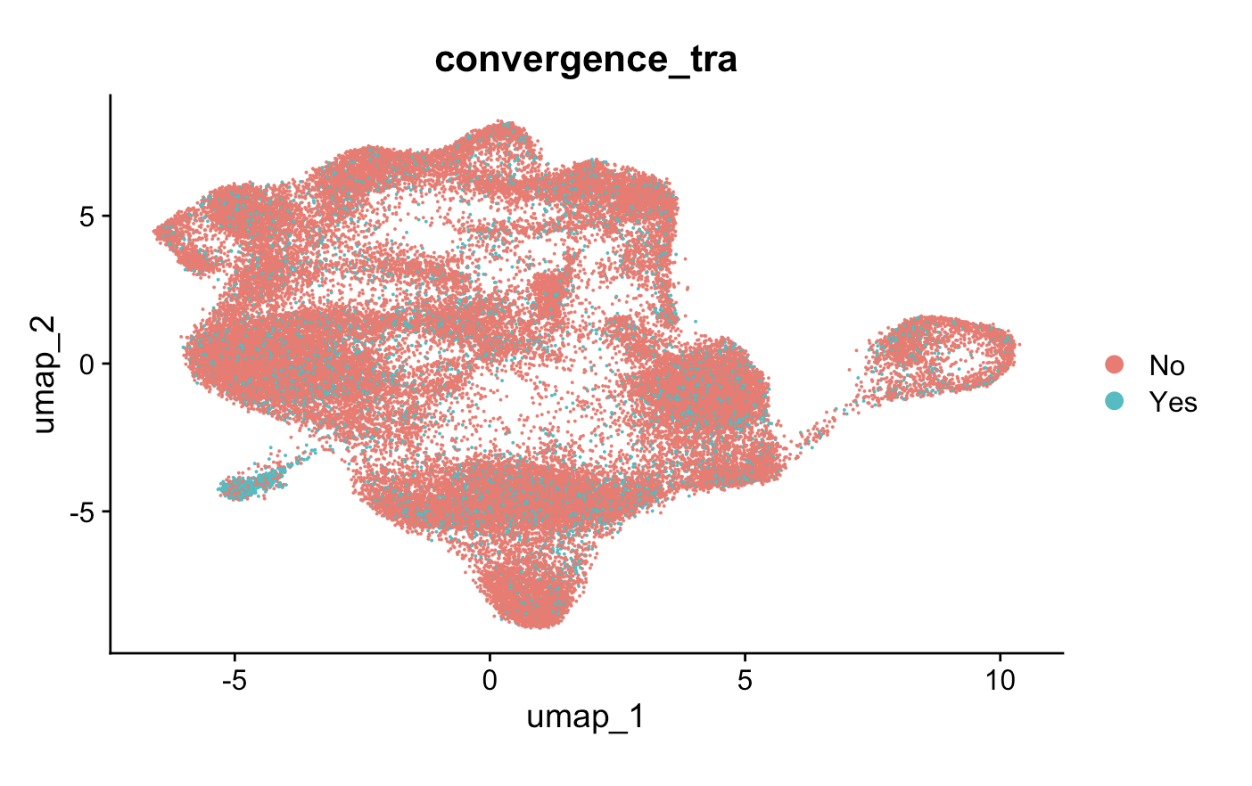
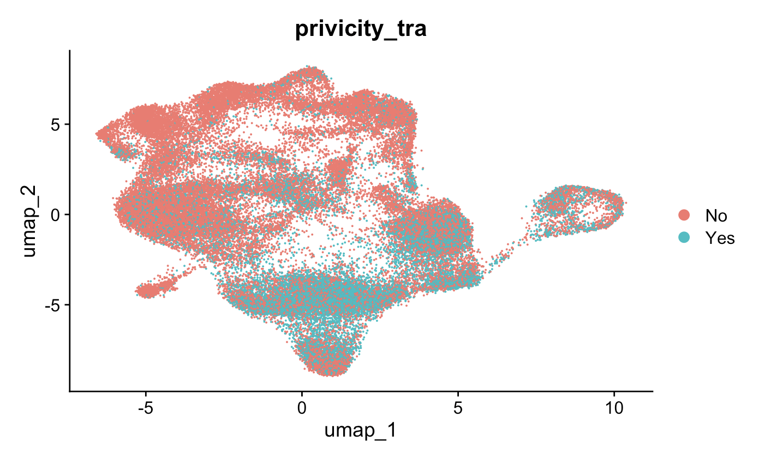
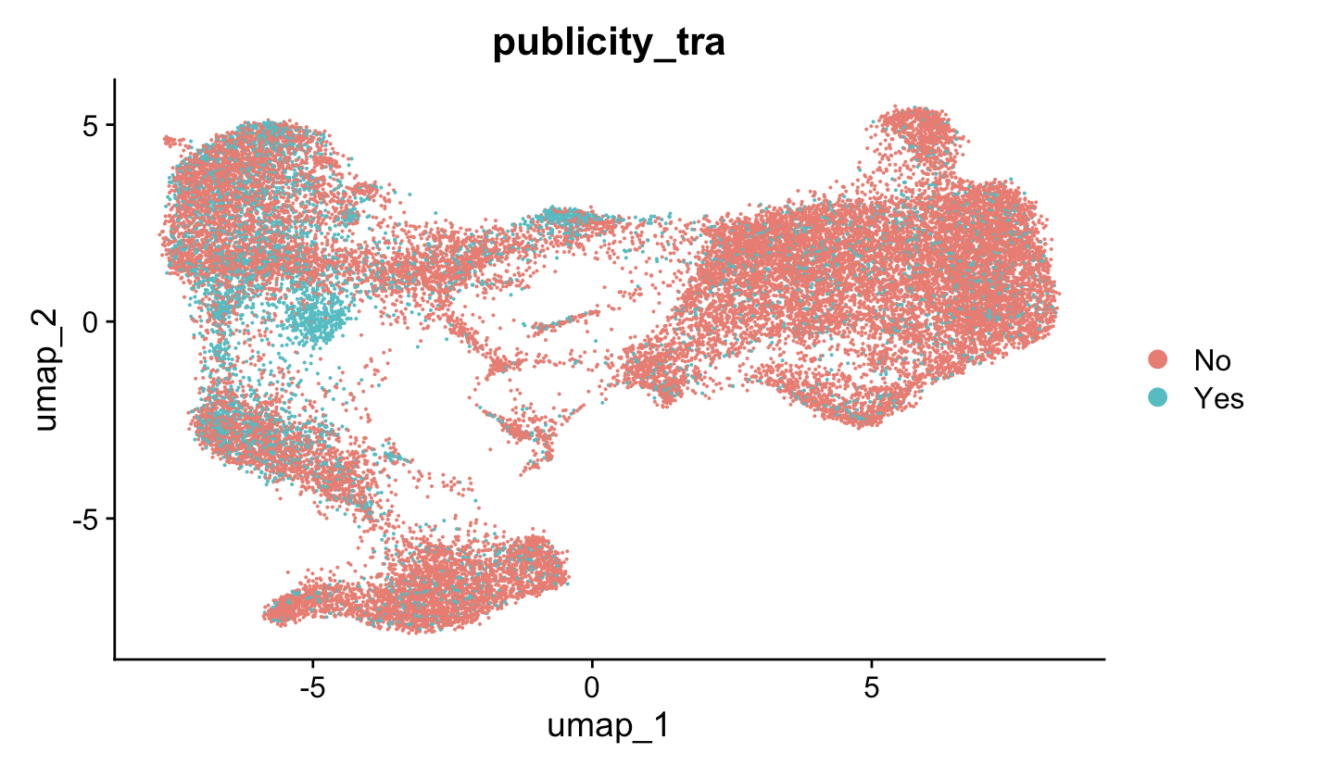
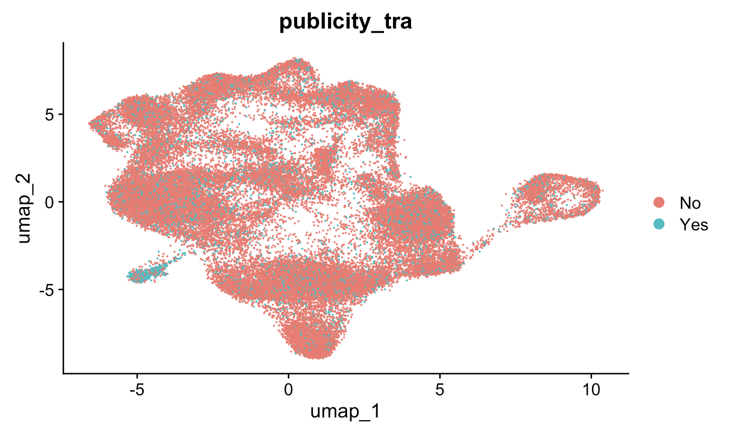
TRA CDR3AA publicity, privicity, convergence-colored UMAPs
PBMC myocarditis-focused dataset
Colon tissue colitis dataset
Notes:
MAITs most public/converged (TRA), as expected

Slide 41

Other T cell convergence differences by irAE group in colon tissue colitis dataset observed because of no converged dnT TRB CDR3AAs

Slide 42
irAEs vs. autoimmune conditions
irAEs progress more rapidly, more transient, often display quicker recovery than autoimmune conditions
Notes:
Immune-related adverse events in various organs caused by checkpoint inhibitors
irAEs progress more rapidly than autoimmune conditions, also transient often with quick recovery
severe irAEs may represent a subclinical or latent autoimmune state that is unmasked upon ICI treatment
Perhaps worth trying to make analogy between viral infections preceeding autoimmunity and tumor response preceeding irAEs?
Immune-related adverse events in various organs caused by checkpoint inhibitors
irAEs progress more rapidly than autoimmune conditions, also transient often with quick recovery
CTLA-4 and PD-1 signaling converge on Akt, regulator of T cell activation
CTLA-4 blockade induces more diversified T cells (including autoreactive ones), PD-1 blockade induce more clonal TCR repertoire and proliferation of intratumoral CD8<sup>+</sup> T cells
severe irAEs may represent a subclinical or latent autoimmune state that is unmasked upon ICI treatment

Slide 43

PD-1 and CTLA-4 blockade induce distinct responses despite both converging on Akt signaling
PD-1 blockade more CD8 (immune “normalizer”), CTLA-4 more CD4 (immune “enhancer”)
PD-1 blockade associated with fewer irAEs
PD-1 blockade induces more clonal TCR repertoire, CTLA-4 blockade induces more diversified TCR repertoire
Notes:
Picture: Advanced materials for management of immune-related adverse events induced by immune checkpoint inhibitors
Distinct cellular mechanisms underlie anti-CTLA-4 and anti-PD-1 checkpoint blockade
- PD-1 blockade predominantly induces expansion of specific tumor infiltrating exhausted-like CD8<sup>+</sup> T cell subsets
- CTLA-4 blockade induces expansion of ICOS<sup>+</sup> Th1-like CD4<sup>+</sup> effector T cells, also engages specific subsets of exhausted-like CD8<sup>+</sup> T cells
Immune-related adverse events in checkpoint blockade: observations from human tissue and therapeutic considerations
PD-1 blockade more CD8 effect, CD4 effect more for CTLA-4 blockade
Mechanisms of immune-related adverse events during the treatment of cancer with immune checkpoint inhibitors
anti-CTLA-4 and anti-PD-1/PD-L1 antibodies called "immune enhancers" and "immune normalizers" (normalizing T cell immunity in tumor microenvironment), respectively, consistent with PD-1 blockade having less irAEs
CTLA-4 and PD-1 signaling converge on Akt, regulator of T cell activation
CTLA-4 blockade induces more diversified T cells (including autoreactive ones), PD-1 blockade induce more clonal TCR repertoire and proliferation of intratumoral CD8<sup>+</sup> T cells

Slide 44
Effect of tumor type on ICB response
TMB generally a good predictor of ICB response
Good ICB responders
Melanoma
NSCLC
Colon/endometrium cancer (if MMRd and with high microsatellite instablility)
Poor ICB responders
Ovarian cancer
Notes:
ovarian cancers ICB resistant, not known why (perhaps TIM-3 checkpoint), despite tumor-infiltrating leukocytes present in most ovarian cancer patients (or perhaps these are bystanders reactive to viruses rather than tumor antigens)

Slide 45
Predictors of ICB response
Debate over TCR repertoire diversity/clonality predicting ICB response
Notes:
Single cell T cell landscape and T cell receptor repertoire profiling of AML in context of PD-1 blockade therapy
- TCR repertoires expand in responders, contract in therapy resistant patients
some circulating PD-1<sup>+</sup> CD8<sup>+</sup> T cells share TCR sequences with T cells in TME, and this frequency predicts ICB response
in responsive patients peripheral compartment is a major source of T cells activated by ICB and majority of pre-existing intratumoral T cells are terminally exhausted and refractory to ICB
T cell repertoire diversity: friend or foe for protective antitumor response?
high TCR diversity/richness/evenness (all same here, highly polyclonal synonyms) in blood associated with good ICB outcome
# A multi-omic single cell sequencing approach to develop a CD8 T cell specific gene signature for anti-PD1 response in solid tumors
- **neither pre-treatment TCR clonality nor changes in clonality after ICB correlate with response**

